Slide 1
Periodic Table Trends

Slide 2
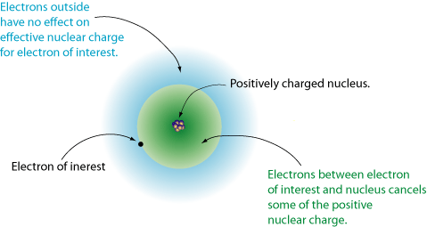
Nuclear Pull
Each electron is simultaneously attracted to the nucleus as it is repelled by the other electrons.
The inner electrons between the nucleus and the electron of interest make up the shield, blocking the nucleus from “pulling” on the outer electrons.

Slide 3
Effective Nuclear Charge
Z_{eff} = Z – S
The shield between the nucleus and the electron is the primary influence on the effective nuclear charge.
Effective nuclear charge: charge felt on valence electrons
Z_{eff} = Effective Nuclear Charge
Z = # of protons
S = Number of inner “core” electrons
You will not need to do this calculation, but it is a VERY good guide to figuring out nuclear pull!

Slide 4
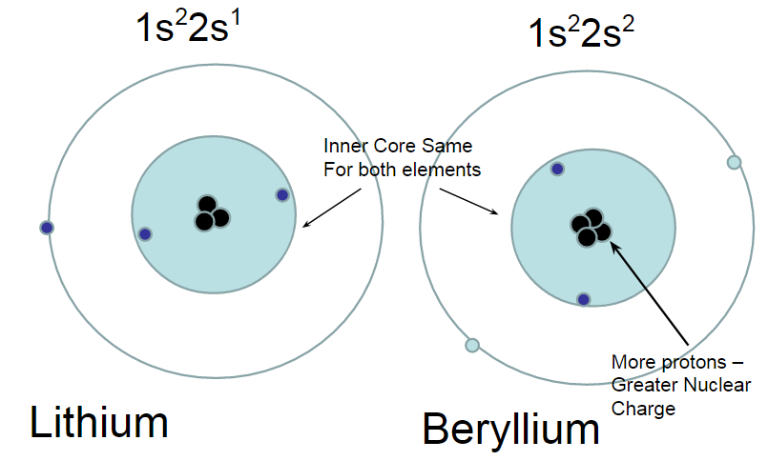
Nuclear Pull:

Slide 5
Learning Check:
In the following pairs, pick the atom that has the greater nuclear pull:
B or F Mg or Si S or Cl
From left to right in a period, nuclear pull ______________.
From top to bottom in a group, nuclear pull ______________.

Slide 6
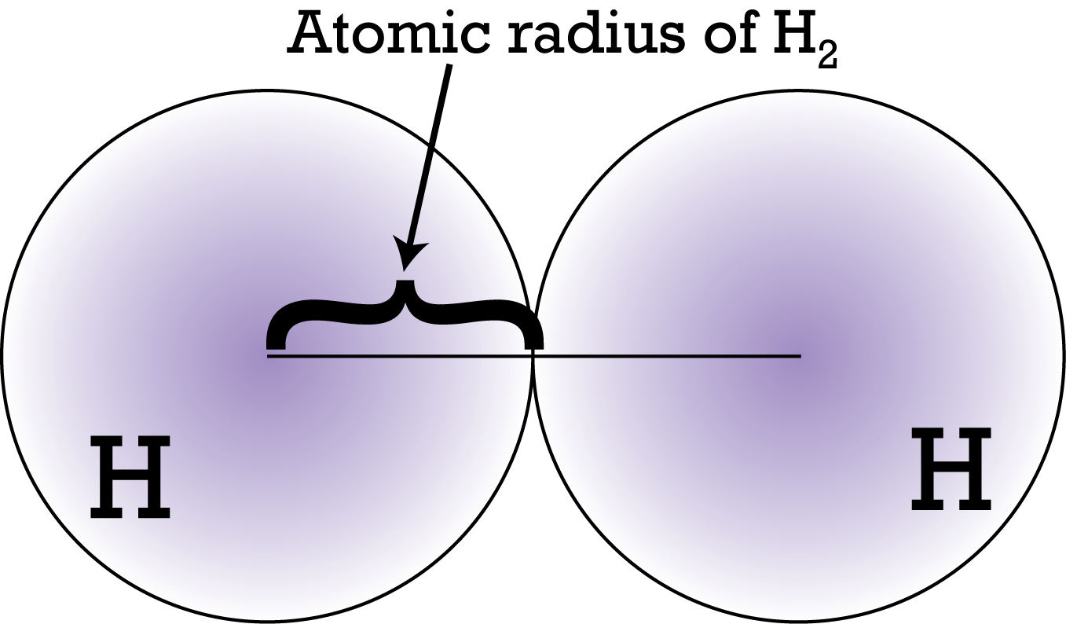
Atomic Radius
Definition: The distance from the nucleus to the outermost electron. In the electron cloud. This measures the size of atoms!
Measurement usually taken when two atoms are bonded.
Units of pm = picometers (that’s a trillionth of a meter!)

Slide 7
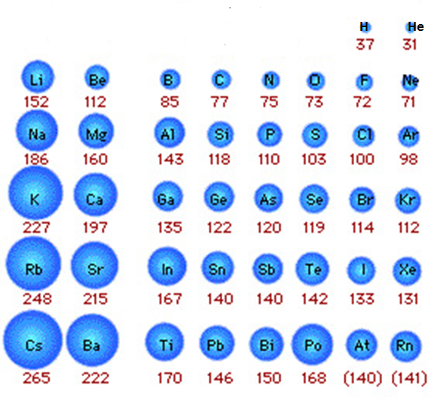
Atomic Radius
Across a Period (left to right)
WHAT: Deceases
WHY: Nuclear Pull
Down a Group (top to bottom)
WHAT: Increases
WHY: More Energy Levels

Slide 8
Learning Check: Atomic Radius
In the following pairs, pick the atom that has the greater atomic radius:
B or F Mg or Si S or Cl
From left to right in a period, atomic radius ______________.
From top to bottom in a group, atomic radius ______________.

Slide 9
Ionization Energy
Definition: The amount of energy needed to remove an electron the ground state from an atom.
Measured in kJ/mol kJ is kilojoules (energy)
mol is moles (amount of substance)

Slide 10
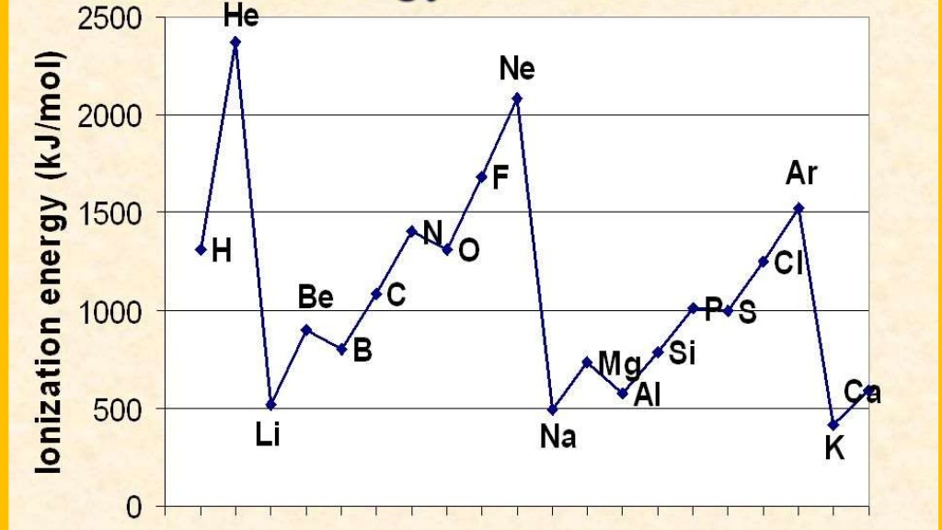
Ionization Energy
Across a Period (left to right)
WHAT: Increases
WHY: Nuclear Pull
Down a Group (top to bottom)
WHAT: Decreases
WHY: More Energy Levels

Slide 11
Learning Check: Ionization Energy
In the following pairs, pick the atom that has the greater ionization energy:
B or F Mg or Si S or Cl
From left to right in a period, ionization energy ______________.
From top to bottom in a group, ionization energy ______________.

Slide 12
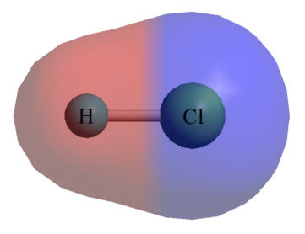
Electronegativity
Definition: The ability of an atom to attract electrons from ANOTHER atom into a bond.
Measured on the Pauling Scale
Values range from 0.0 to 4.0 and have NO UNITS.

Slide 13
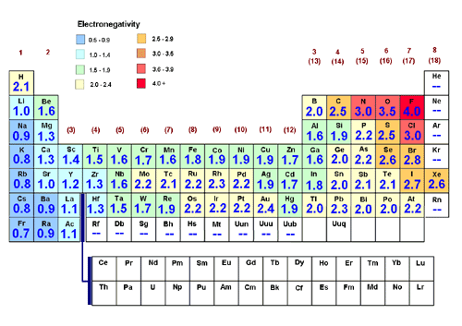
Electronegativity
Across a Period (left to right)
WHAT: Increases
WHY: Nuclear Pull
Down a Group (top to bottom)
WHAT: Decreases
WHY: More Energy Levels

Slide 14
Learning Check: Electronegativity
In the following pairs, pick the atom that has the greater electronegativity:
B or F Mg or Si S or Cl
From left to right in a period, electronegativity ______________.
From top to bottom in a group, electronegativity ______________.

