Slide 1
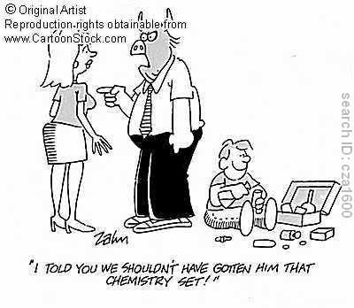
Predicting Products: Reviewing Types of Reactions
Addition (Synthesis)
Decomposition
Single Displacement (Replacement)
Double Displacement (Replacement)
Acid-Base Reaction
Combustion

Slide 2
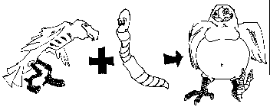
Addition (Synthesis)
Two or more substances combine to form a new compound
A + B → AB
Fe + O₂→ Fe₂O₃

Slide 3
Decomposition
Compounds are broken down into two or more smaller compounds
AB → A + B
SiCl₄ → Si + 2Cl₂

Slide 4
Practice Questions:
Predict the products and balance of the following reactions: Mg + Cl₂ → CaF₂ →

Slide 5
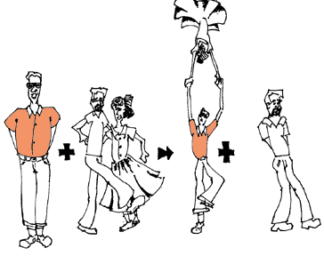
Single Displacement
One element replaces another in a compound
AX + B → BX + A
Ca + 2 HCl → CaCl₂ + H₂

Slide 6
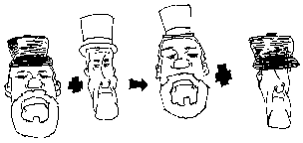
Double Displacement
Ions switch places; two elements switch places
AB + CD → AD + CB
AgNO₃ + NaCl → AgCl + NaNO₃

Slide 7
Acid-Base Reaction
Double Displacement reaction that ends in H₂O and a salt
AB + CD → Salt + H₂O
HCl + NaOH → NaCl + H₂O
SALT WATER
*This is for an acid and a base that are equal strength only.

Slide 8
Practice Questions:
Predict the products and balance of the following reactions: MgF₂ + Cl₂ → CaF₂ + NaOH → HNO₃ + Mg(OH)₂ →

Slide 9
Combustion
Carbon compound combines with oxygen to release carbon dioxide and water.
Hydrocarbon + O₂ → CO₂ + H₂O
C₂H₆ + 7 O₂→ 4 CO₂ + 6 H₂0
But don’t forget that ENERY is a product too (heat, light, etc)…

Slide 10
Practice Questions:
Predict the products and balance of the following reactions: CH₄ + O₂ → C₂H₆ + O₂ →

Slide 11
Lies…. Lies…. and more lies!
In truth, not all of the reactions on your worksheets and in our practice problems actually react.
Whether or not a reaction takes place can be determined by using two reference sheets:
“Solubility Rules”
“Activity Series”

