Slide 1
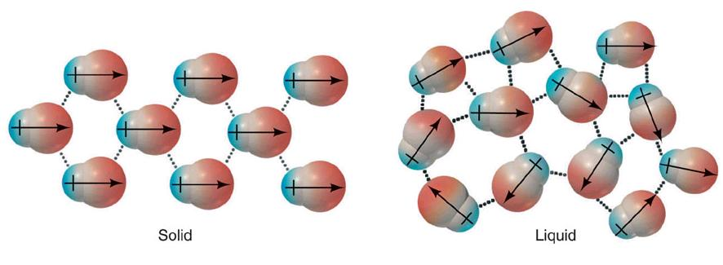
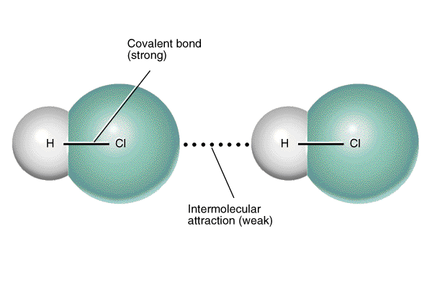
Intermolecular Forces
(IMFs)
The forces that hold one molecule to another

Slide 2
Learning Targets of TODAY!
I CAN state the 6 intermolecular forces.
I CAN classify a molecule based off its intermolecular forces.
I CAN justify how a compound’s properties are affected by its intermolecular forces (surface tension, volatility, capillarity, solubility, boiling point, melting point)
I CAN predict the state of matter for a given compound using my knowledge of its intermolecular forces.
I CAN compare physical properties of two substances given their formula or name.

Slide 3
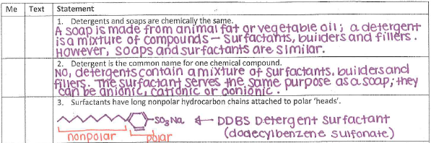
Correcting Homework #1-3:

Slide 4
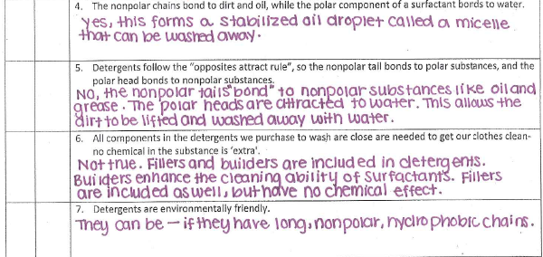
Correcting Homework #4-7:

Slide 5
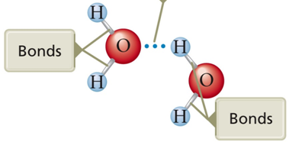
Intramolecular Forces
These are forces that are between atoms and are called bonds.
They can be ionic, polar or nonpolar covalent, and metallic.
These forces are very strong and hold molecules and compounds together.

Slide 6
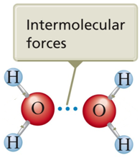
Intermolecular Forces
These are forces that are “between” the molecules.
There are SIX kinds of intermolecular forces, and have different STRENGTHS depending on the molecules interacting.

Slide 7
Intermolecular Forces (IMF)
Macro-covalent
Macro- ionic
Metallic
Hydrogen
Dipole-Dipole
Dispersion

Slide 8
1. Macro-Covalent
The strongest of them all.
Examples:
      Diamond (all Carbon atoms)
      Rocks (Silicon and Oxygen)
Held together by covalent bonds
Hard, high melting point
Poor conductor of heat and electricity
Solids

Slide 9
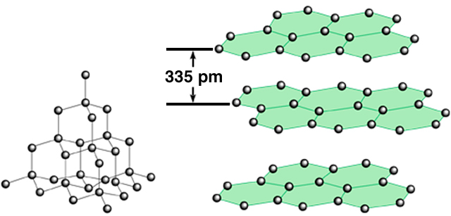
1. Macro-Covalent
Allotropes:
carbon
atoms
diamond
graphite

Slide 10
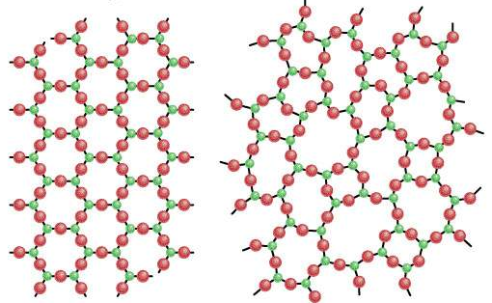
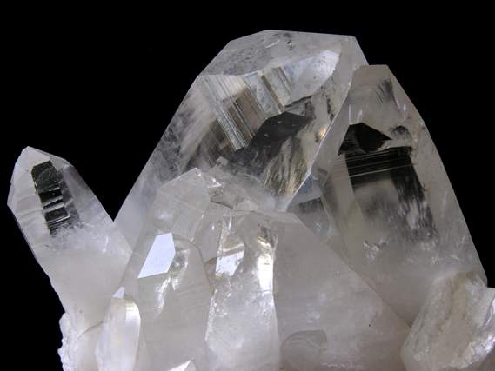
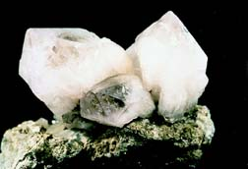
Crystalline
quartz (SiO₂)
Non-crystalline
quartz glass

Slide 11
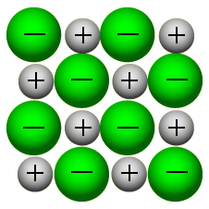
2. Macro- ionic
Very strong
Permanent strong charge interactions
Usually crystal in formation (solids)
Very high melting points

Slide 12
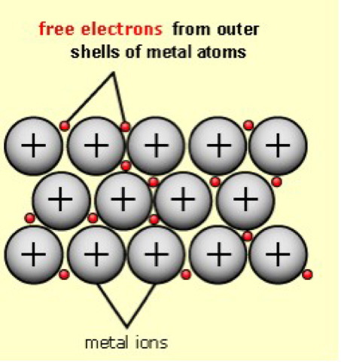
3. Metallic
Solids at room temperature
STRONG Intermolecular Forces
Metal Atoms give up electrons
This creates many dipoles throughout the atoms, they SHIFT but are always there
“SEA of electrons”

Slide 13
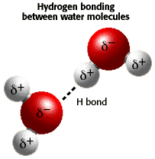
4. Hydrogen Bonding
A strong intermolecular attractions
Caused by very strong dipole-dipole attraction between molecules with N-H, O-H, and F-H bonds.
Responsible for many of water’s special properties.
Liquids

Slide 14
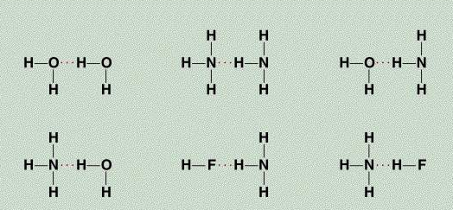
4. Hydrogen Bonding
The hydrogen bond is a special dipole-dipole interaction between the hydrogen atom in a polar N-H, O-H, or F-H bond and an electronegative O, N, or F atom. IT IS NOT A BOND.
A
H
…
B
or
A
H
…
A
A & B are N, O, or F

Slide 15
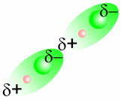
5. Dipole-Dipole
Caused by attraction of positive end of one polar molecule to negative of another polar molecule.
Attractive forces between polar molecules
Liquids

Slide 16
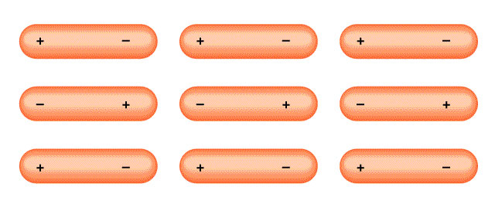
5. Dipole-Dipole
Orientation of Polar Molecules

Slide 17
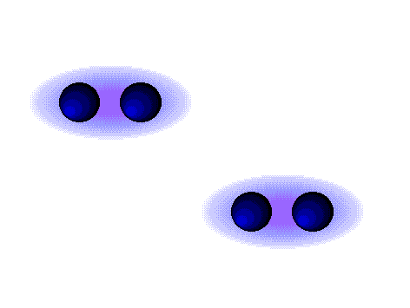
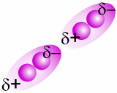
6. ‘London’ Dispersion Forces
Get stronger with increase in mass
Gas
Only attractive force between non-polar molecules (symmetrical or those with only non-polar bonds) or single atoms.
Momentary Dipole

Slide 18
Practice
Write phase and IMF for each
H₂O
CCl₄
CH₂O
NH₃
Hg
NaCl

Slide 19
Answers
H₂O – Hydrogen Bonding - Liquid
CCl₄ – London Dispersion Forces - Gas
CH₂O –Dipole-Dipole - Liquid
NH₃ – Hydrogen Bonding - Liquid
Hg – Metallic - Liquid
NaCl – Ionic - Solid

Slide 20
Physical Properties Affected by IMFs
Surface Tension
Volatility
Capillarity
Solubility→ “Like dissolves like”
Boiling and Melting Point

Slide 21
Volatility
Affects of Intermolecular Forces
Ability to evaporate
Volatility is high when IMFs are weak. Why?
Compare volatility of alcohol and water.
Capillarity
Ability to climb up a tube or surface
ONLY with liquids
High when liquid molecules are attracted to the tube or surface.
Ex. Meniscus, paper towels, blood test

Slide 22
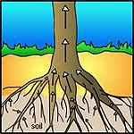
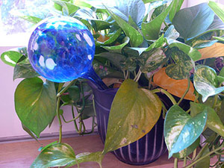
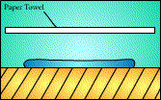
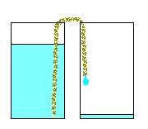
Capillary Action

Slide 23
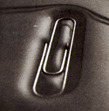
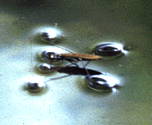
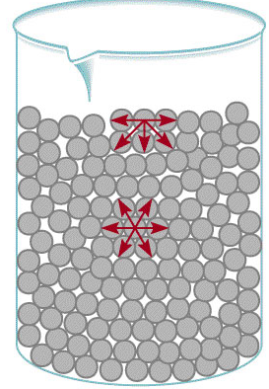
Surface Tension
A “skin” develops on the surface of liquids.
Water’s is very strong.
High when molecules are attracted to each other→ cohesion.
Ex. Paper clip “floating”
Water striders

Slide 24
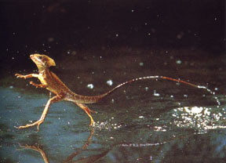
Basilisk Lizard
https://youtu.be/45yabrnryXk

Slide 25
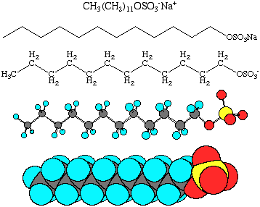
Surfactants
Molecules that act to disrupt a liquid’s surface tension→ “wetting agent”
Structure-long non-polar hydrocarbon tail and a polar or ionic head

Slide 26
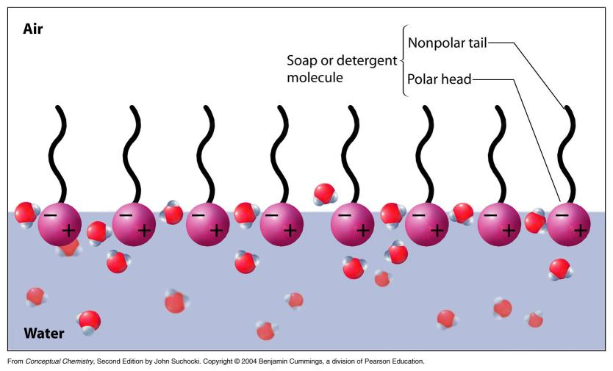
How do they work?
Disrupt surface tension by acting like a “wedge”

Slide 27
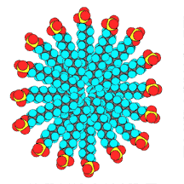
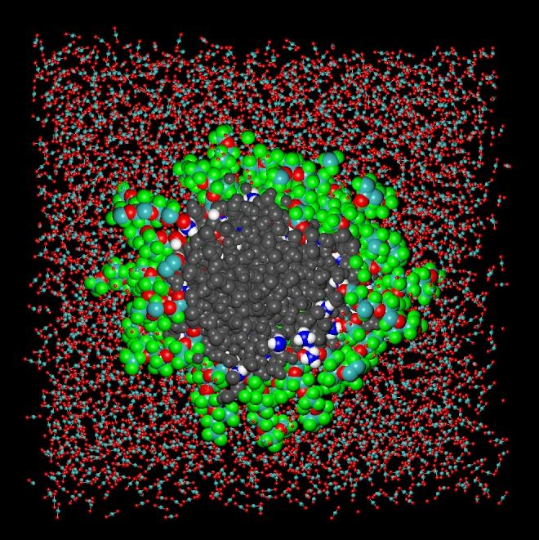
Surfactants as Cleaning Agents
Non-polar hydrophobic (water-hating) tails and polar or ionic hydrophilic (water-loving) heads form micelles.

Slide 28
Surfactants
https://www.youtube.com/watch?v=cdKlyofu0Xw

Slide 29
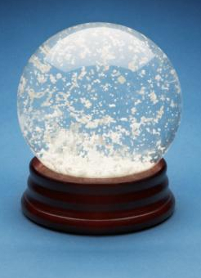
Solubility
How does a snow globe work?

Slide 30
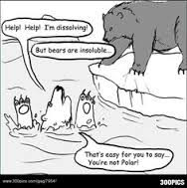
Solubility

Slide 31
Solubility
What dissolves in what?
Ionic substances dissolve in water
Covalent compounds:
A. Non-polar dissolves in non-polar solvents.
B. Polar solutes dissolve in polar solvents.
C. Partially polar (only polar in a small part of the molecule) solutes dissolve in partially polar solvents.
Like Dissolves Like!

Slide 32
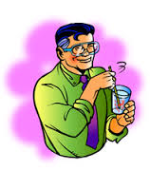
Will it dissolve in water??
Ammonia (NH₃)
Methane gas (CH₄)
Calcium chloride (CaCl₂)
Iron (Fe)
Carbon dioxide (CO₂)
Ethanol (C₂H₅OH)

Slide 33
Answers
Ammonia (NH₃) --Dissolves
Methane gas (CH₄)—Doesn’t dissolve
Calcium chloride (CaCl₂)--Dissolves
Iron (Fe)—Doesn’t dissolve
Carbon dioxide (CO₂)—Doesn’t dissolve
Ethanol (C₂H₅OH)--Dissolves

Slide 34
Melting Point & Boiling Point
Strong IMFs have higher melting and boiling points.
This is because it takes more energy to break the intermolecular forces that are holding the molecules together.

Slide 35
Practice!

