Slide 1
Gas Stoichiometry

Slide 2
Gases Stoichiometry… One more time!
What is the minimum mass of zinc needed to react with nitric acid to produce 15.6 mL of H₂ gas in the reaction at STP?
*Remember at STP we can use 22.4 L gas = 1 mol gas

Slide 3
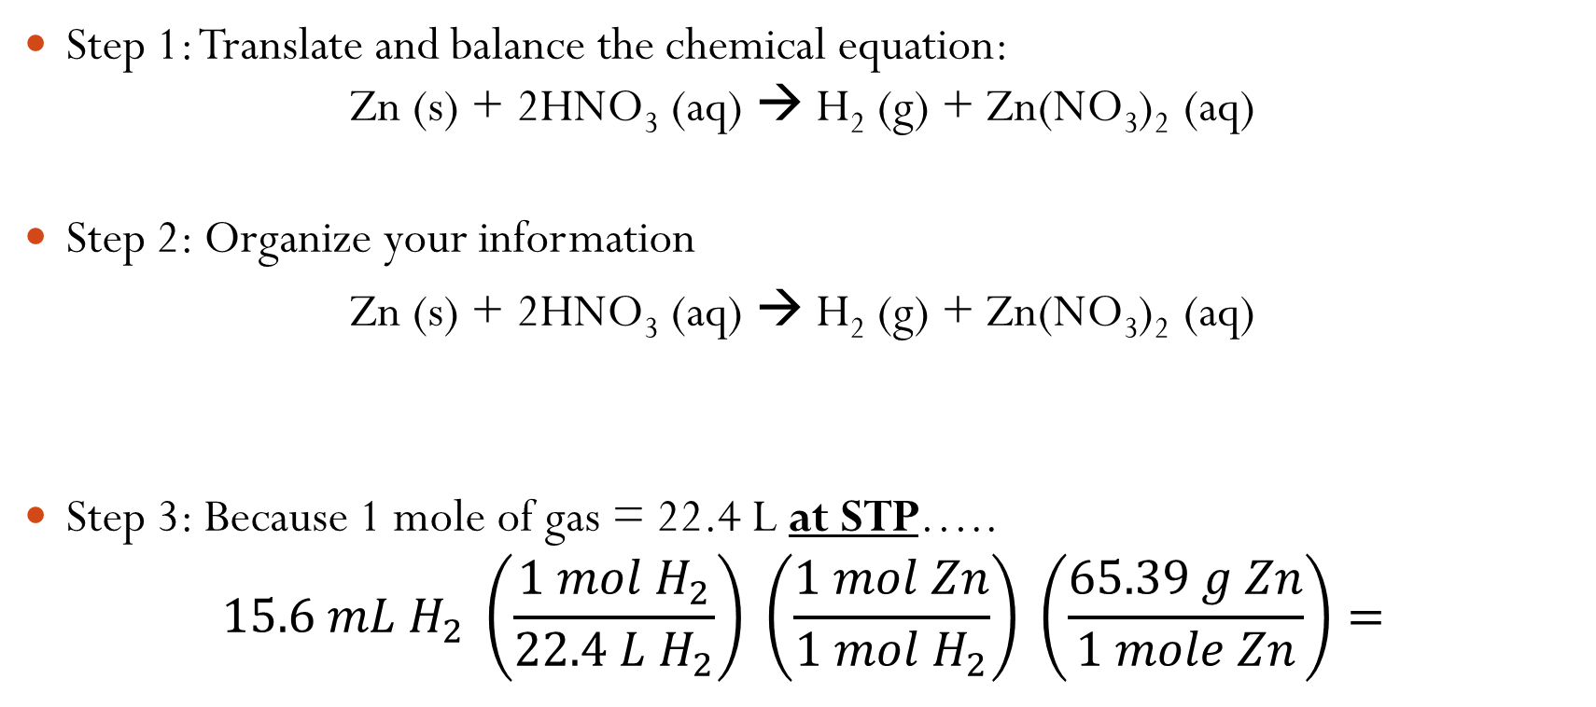
Gas Stoichiometry: What is the minimum mass of zinc needed to react with nitric acid to produce 15.6 mL of H₂ gas in the reaction at STP?
Step 1: Translate and balance the chemical equation: Zn (s) + 2HNO₃ (aq) → H₂ (g) + Zn(NO₃)₂ (aq)
Step 2: Organize your information
Zn (s) + 2HNO₃ (aq) → H₂ (g) + Zn(NO₃)₂ (aq)
Step 3: Because 1 mole of gas = 22.4 L at STP…..
$$15.6 mL H_{2} \left(\frac{1 mol H_{2}}{22.4 L{ H}_{2}}\right) \left(\frac{1 mol Zn}{1 mol H_{2}}\right) \left(\frac{65.39 g Zn}{1 mole Zn}\right)=$$
? grams
15.6 mL

