Slide 1
Nuclear Reactions
Fission and Fusion

Slide 2
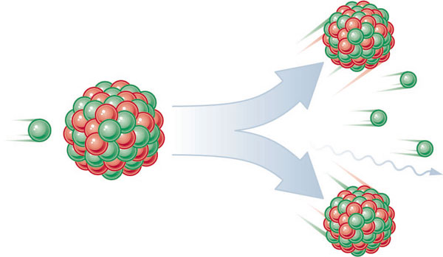
Nuclear Fission
Fission means “to divide”
Nuclear fission is the process of splitting a large nucleus into two nuclei with smaller masses.
Additionally, more neutrons are released, as well as large amounts of energy.

Slide 3
Nuclear Fission
Only large nuclei with atomic numbers above 83 can undergo fission.
The absorption of the neutron causes an instability inside the nucleus.
A reaction occurs that produces a lot of energy!

Slide 4
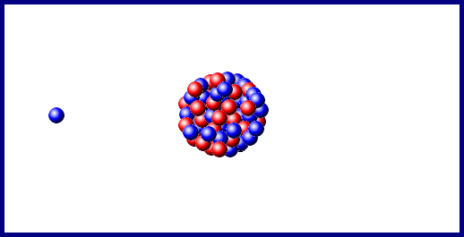
Fission

Slide 5
Fission: Chain Reactions
A chain reaction is an ongoing series of fission reactions. Billions of reactions occur each second in a chain reaction.
The additional neutrons produced from the previous reaction go on to split new atoms.

Slide 6
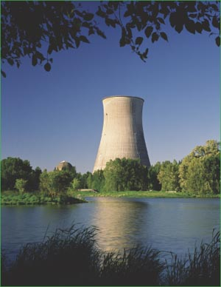
Nuclear Energy
There is a tremendous amount of energy found within atoms and there are special types of reactions that are unique to the nucleus of some atoms.
These reactions have been important throughout history and still are important today.

Slide 7
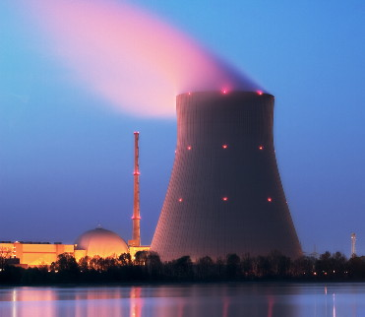
CONTROLLED Chain Reactions
On earth, nuclear fission reactions take place in nuclear reactors, which use controlled chain reactions to generate electricity.
Products are Radioactive and must be stored!

Slide 8
Virtual Tour of Power Plant

Slide 9
UNCONTROLLED Chain Reactions
Uncontrolled chain reactions take place during the explosion of an atomic bomb.

Slide 10
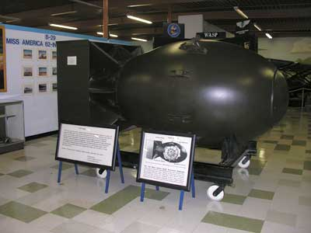
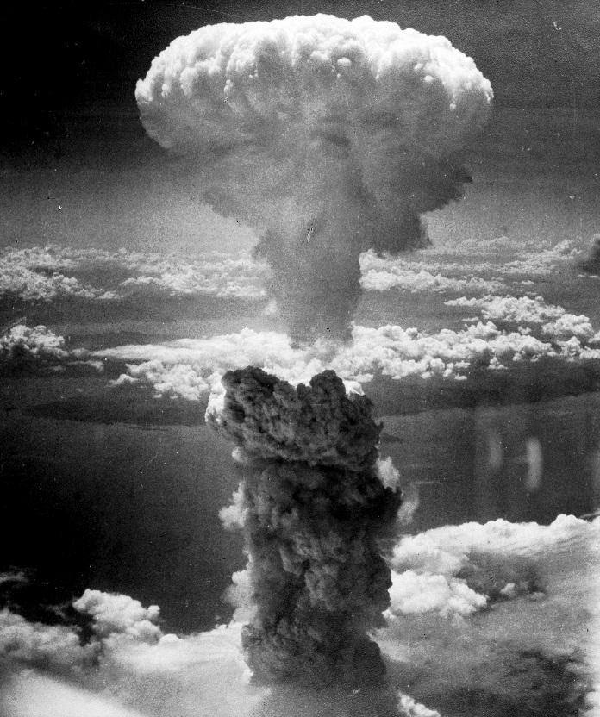
Some Nuclear Energy is Dangerous…. Like Using Atomic Bombs
Nuclear Bomb of 1945 known as “fat man” was dropped on the Japanese city of Nagasaki.
It along with “little boy” dropped on Hiroshima were the first time nuclear bombs were used in war.
Their destruction was nothing like the world had ever seen at the time!

Slide 11
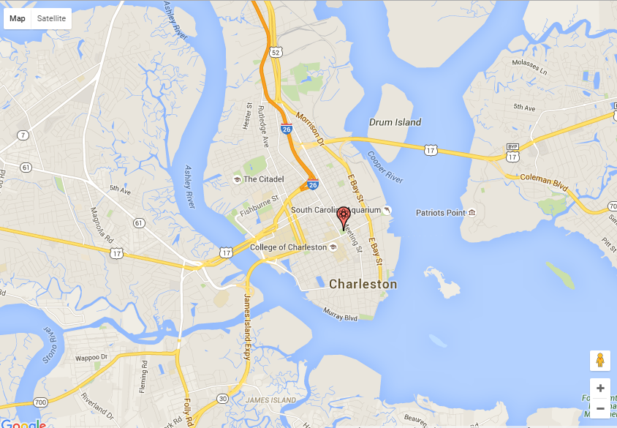
What would that do today?

Slide 12
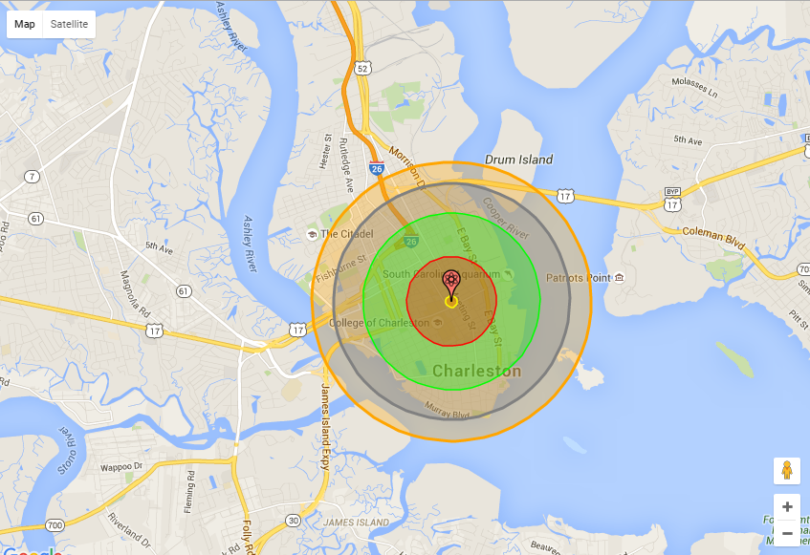
Red = 100 % building destruction Green = Lethal Radiation dose 90% Blue= Most building collapse Orange = 3rd degree burns to all exposed

Slide 13
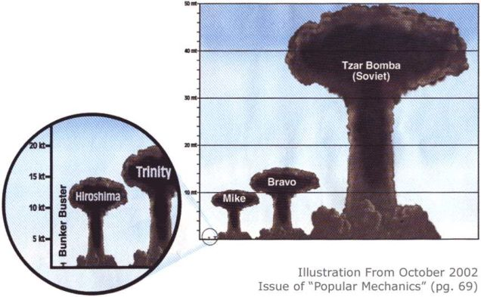
WWII Was Bad…. BUT….

Slide 14
So... What Does That Look Like?

Slide 15
Nuclear Fusion
Nuclear fusion is the combining of two small nuclei with low masses to form one nucleus of larger mass.
Hydrogen reactions are the most common.
Nuclear fusion reactions are also called thermonuclear reactions.

Slide 16
Nuclear Fusion
Fusion reactions exist in the sun, stars, and supernovas.
Also occurs in “Thermonuclear” Weapons – Hydrogen Bombs
It is difficult to create fusion reactions on earth since they need temperatures above one million degrees Celsius in order to take place.

Slide 17
Nuclear Fusion
Source of Fuel for Nuclear Fusion is just isotopes of Hydrogen.
The products of fusion reactions are Helium, a neutron, and extreme amounts of energy.

Slide 18
Einstein’s Equation
E = mc²
E=mc² which applied to nuclear fission, fusion and radioactive decay.
E= Energy
M = Mass
C = Speed of Light (always the same)

Slide 19
Einstein’s Equation
Converting 1 kg of Uranium-235 into energy.
E = mc²
E = (1kg) * (300,000,000m/s)²
E = 90,000,000,000,000,000 Joules
E = 9x10¹⁶ joules
Energy produced burning 1 kg of coal
E = 31,000,000 joules
E = 3.1 x 10⁷ joules
So: if 1kg of Uranium-235 was converted into energy, it will produce over 1 trillion times the energy of 1kg of coal being burned!
Granted, it’s very hard to get this much Uranium to turn into energy all at once, but that’s exactly what happens in our nuclear power plants.

