Slide 1
Equilibrium
The summation of all things!

Slide 2
3 questions that chemists have:
Will a reaction occur?
If it does, how fast will it happen?
If it does, how far will it go?

Slide 3
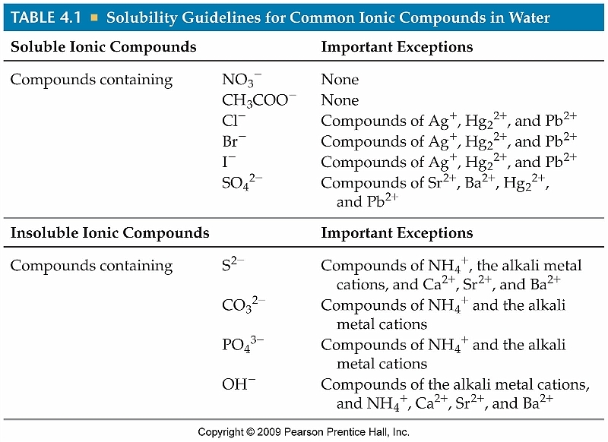
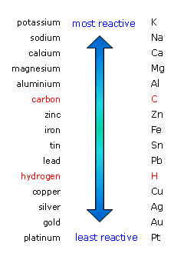
Question #1: will a reaction occur?
You learned about this in the unit on chemical reactions.
Remember these?
Certain reactions will not occur because certain metals are not reactive, or because a precipitate will not form.

Slide 4
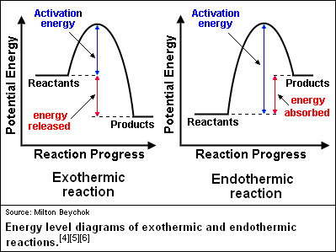
Question #2: How fast will the reaction be?
You learned about this in thermochemistry.
Remember these?
Certain reactions will absorb heat and certain reactions will release heat.
What are the factors that could increase the rates of reactions?
Increasing temperature (and alternately… pressure!)
Increasing concentration
Increasing surface area
Increasing stirring (agitation)
Catalysts!

Slide 5
Question #3: how far will it go?
Dynamic Equilibrium: The condition in which the rate of the forward reaction is equal to the rate of the reverse reaction. H₂ + Cl₂ $⇌$ 2HCl
When dynamic equilibrium is reached, the concentrations of the reactants and products no longer change.
This DOES NOT mean that the concentrations of reactants and products are the same.
Some reactions reach equilibrium when most of the reactants have formed products.
Some reactions reach equilibrium when only a small fraction of the reactants have formed products.
THIS IS NOT ABOUT CONCENTRATION. THIS IS ABOUT RATES OF REACTIONS.

Slide 6
Le ChÂtlier’s principle
Le Châtlier’s principle: When a chemical system at equilibrium is disturbed, the system shifts in a direction (towards the reactants or products) that minimizes the disturbance.

Slide 7
So… what does that mean?
Remember the definition of Dynamic Equilibrium: The condition in which the rate of the forward reaction equals the rate of the reverse reaction.
Le Châtlier’s Principle discusses things that will change the rates of reactions.
What are things that affect the rates of reactions, again?
Concentration of reactants (and products!)
Temperature
Pressure

Slide 8
Le ChÂtlier’s principle: change in concentration
Changing the concentration of a chemical (either a reactant or a product) will shift the equilibrium to the side that would reduce the change in concentration.
For example. Look at the following reaction:
H_{2 (g)} + Cl_{2 (g)} $⇌$ 2HCl _{(g)} ΔH = -184.60 kJ
If we added more H₂ gas to the reaction, which direction would it shift towards?
If we added more HCl to the reaction, which direction would it shift towards?
If we remove Cl₂ from the reaction, which direction would it shift towards?
SOLIDS have NO EFFECT ON CHANGES IN CONCENTRATION.

Slide 9
Le ChÂtlier’s principle: change in temperature
Changing the temperature of a chemical (either a reactant or a product) will shift the equilibrium to the side that would reduce the change in temperature.
For example. Look at the following reaction:
H_{2 (g)} + Cl_{2 (g)} $⇌$ 2HCl _{(g)} ΔH = -184.60 kJ
Is the reaction endothermic or exothermic?
If we put this reaction in ice water, which direction would it shift towards?
If we put this reaction on a hot plate, which direction would it shift towards?

Slide 10
Le ChÂtlier’s principle: change in pressure
Changing the pressure of a chemical (either a reactant or a product) will shift the equilibrium to the side that would reduce the change in pressure.
Pressure is special because it only affects gases. If there is an increase in pressure, the equilibrium will shift to the side of the reaction with fewer moles of gas. (The opposite is true for a decrease in pressure.)
For example. Look at the following reaction:
N_{2 (g)} + 3H_{2 (g)} $⇌$ 2NH_{3 (g)} ΔH = -92.22 kJ
Which side has more moles of gas?
If we change the pressure from 1.00 atm to 0.25 atm, which direction would it shift towards?
If we change the pressure from 0.70 atm to 1.50 atm, which direction would it shift towards?

