Slide 1
Solutions
They’re baaaaaaaack!

Slide 2
What is a solution?
Talk to your neighbor and try to come up with a definition.

Slide 3
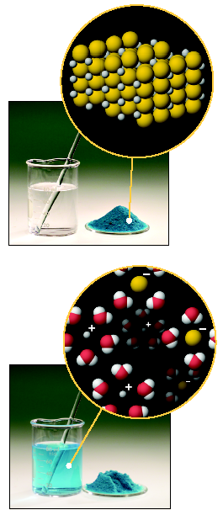
Definitions
A solution is a homogeneous mixture of 2 or more substances
-consistent throughout

Slide 4
Parts of a Solution
SOLUTE – the part of a solution that is being dissolved (usually the lesser amount)
SOLVENT – the part of a solution that dissolves the solute (usually the greater amount)
Solute + Solvent = Solution
Solute | Solvent | Example
solid | solid | Alloys (brass, steel)
solid | liquid | Salt water
gas | solid | Air bubbles in ice cubes
liquid | liquid | Green Tea Lemonade
gas | liquid | Soft drinks
gas | gas | Air

Slide 5
Solubility
The amount of solute that dissolves in a specific amount of solvent.
Expressed as grams of solute in 100 grams ( or ml) of solvent water.
Grams of solute
100 g/ml water

Slide 6
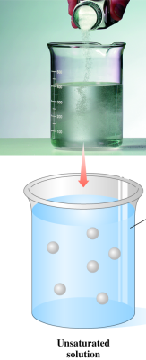
Types of Solutions
Unsaturated
Contain less than the maximum amount of solute.
Can dissolve more solute.
Dissolved solute

Slide 7
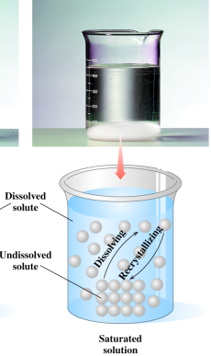
Types of Solutions
Saturated
Contain the maximum amount of solute that can dissolve.
Has undissolved solute at the bottom of the container.

Slide 8
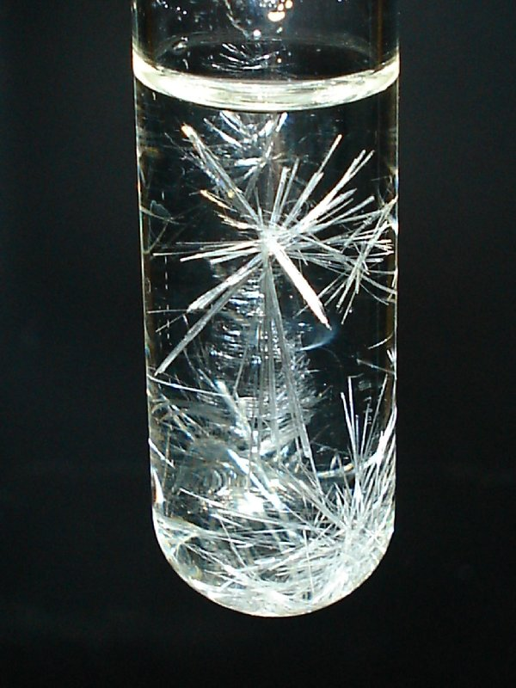
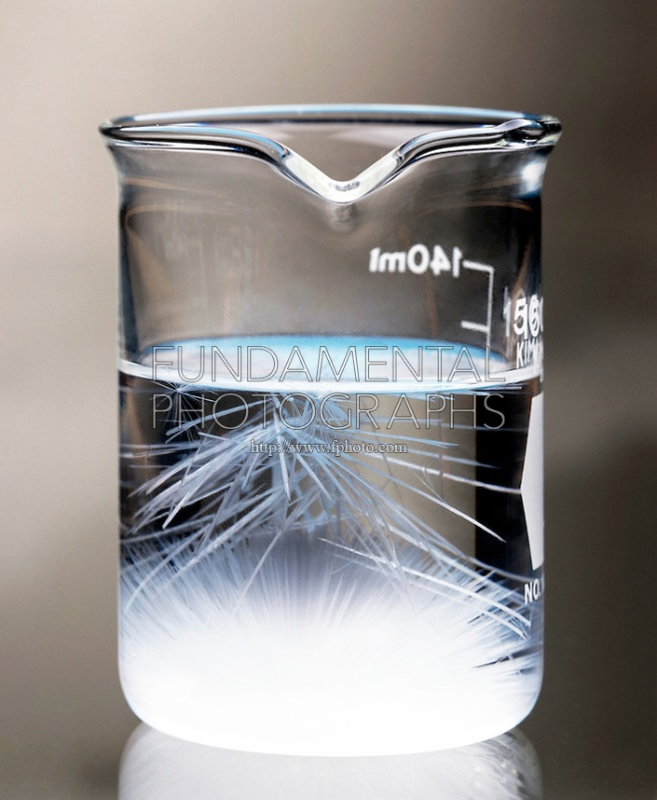
Types of Solutions
Supersaturated
An unstable solution that contains an amount of solute greater than normal.

Slide 9
Learning Check
At 40°C, the solubility of KBr is 80 g/100 g H₂O.
Identify the following solutions as either saturated,
unsaturated, or supersaturated.
A. 60 g KBr added to 100 g of water at 40°C.
B. 120 g KBr added to 200 g of water at 40°C.
C. 75 g KBr added to 50 g of water at 40°C.

Slide 10
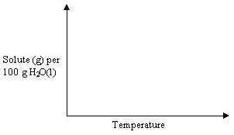
Solubility Curve
Saturated
Supersaturated
Unsaturated

Slide 11
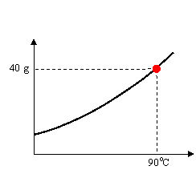
Solubility Curve
Any point on a line represents a Saturated Solution.
Example
At 90ºC, 40 g of NaCl(s) in 100g H₂O(l) represent a saturated solution.
In a saturated solution, the solvent contains the maximum amount of solute.

Slide 12
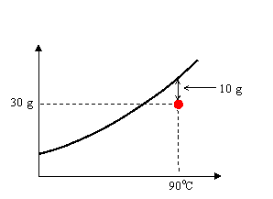
Solubility Curve
Any point below a line is an Unsaturated Solution.
In an unsaturated solution, the solvent contains less than the maximum amount of solute.
Example
At 90ºC, 30 g of NaCl(s) in 100g H₂O(l) represent an unsaturated solution.
How much is required to saturate the solution?

Slide 13
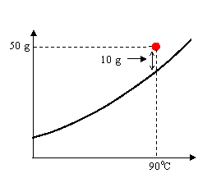
Solubility Curve
Any point above a line is a Supersaturated Solution
In a supersaturated solution, the solvent contains more than the maximum amount of solute. A supersaturated solution is unstable and the excess amount can precipitate or crystallize.
Example
At 90ºC, 50 g of NaCl(s) in 100g H₂O(l).
How much will NaCl(s) will precipitate?

Slide 14
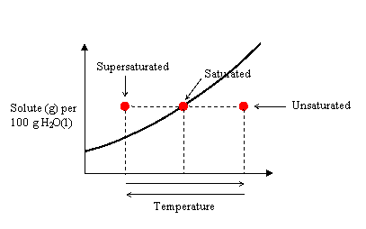
Solubility Curve
Any solution can be made saturated, unsaturated, or supersaturated by changing the temperature.

