Slide 1
Redox Reactions
What happens when the electrons are moving?

Slide 2
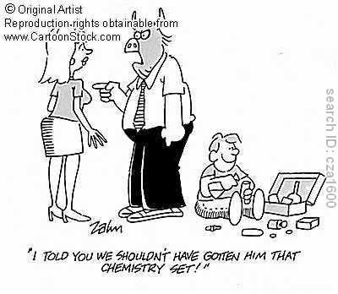
6 Types of Chemical Reactions
All chemical reactions can be described in terms of something moving. The 6 Types of reactions are classified as follows:
Movement of Electrons:
Addition
Decomposition
Single Displacement
Combustion
Movement of Ions:
Double Displacement
Movement of Protons:
Acid-Base

Slide 3
Moving Electrons
In these reactions, one or more electrons move from one atom to another, allowing those atoms to act differently than in their original compounds.
Examples:
SYNTHESIS: Mg + Br₂ → MgBr₂
DECOMPOSITION: NaCl → Na + Cl₂
SINGLE REPLACEMENT: Zn + CuSO₄ → Cu + ZnSO₄

Slide 4
This first example should make sense because this is simply the creation of an ionic bond, from the transfer of electrons:
Mg + Br₂ → MgBr₂

Slide 5
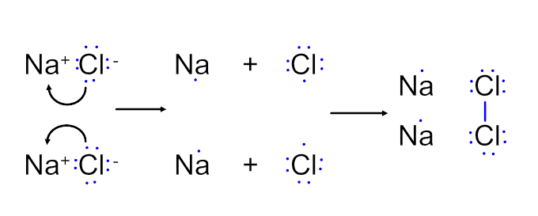
The second example is just the opposite, breaking down an ionic bond.
2NaCl → 2Na + Cl₂

Slide 6
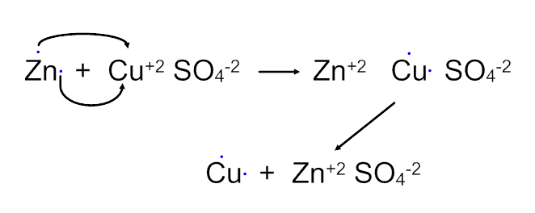
Remember CuSO₄ is an ionic compound, so it really is made of Cu⁺² and SO₄⁻², while Zn is starting off neutral in the reactants
During this reaction, Zn transfers its electrons to Cu⁺², turning the metals into a Zn⁺² ion and a neutral Cu atom.
Now that Zn⁺² has a charge, it will form the ionic compound with SO₄⁻² because of opposite charges.
Zn + CuSO₄ → Cu + ZnSO₄

Slide 7
In this case, did the sulfate ion see an change of electrons?
No, so these electrons were not involved in the reaction and weren’t shown, but remember sulfate has 2 extra electrons to make its structure stable (the -2 charge)

Slide 8
Reduction and Oxidation
In these reactions, one atom or element is reduced and the other is oxidized
These are called Redox reactions
A substance that is reduced has gained electrons (it is reduced in charge)
A substance that is oxidized has lost electrons

Slide 9
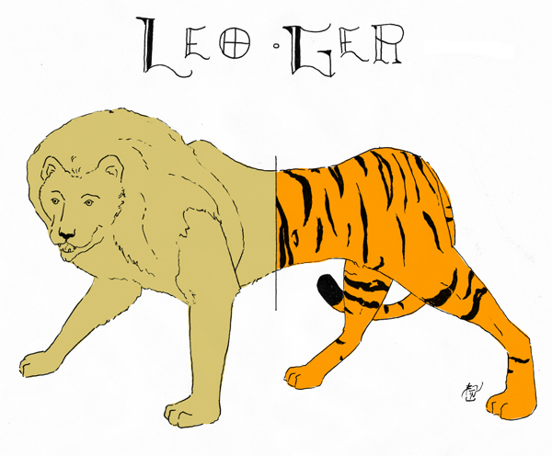
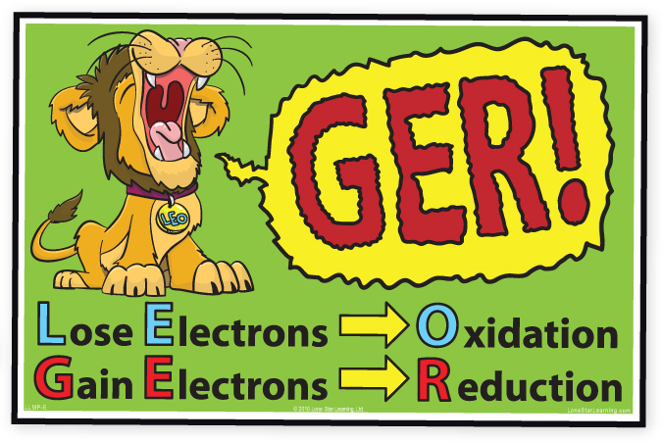
Way to Remember
LEOGER or
LEO the lion says GER
Losing
Electrons is
Oxidation,
Gaining
Electrons is
Reduction

Slide 10
And now, the tricky part…
A substance that has been oxidized is called a reducing AGENT because it caused the other substance to take their electrons
A substance that has been reduced is called an oxidizing AGENT because it caused the other substance to give up its own electrons

Slide 11
Br starts with 0 charge and ends with -1
The charge has gone down, because Br has gained electrons.
Mg starts with 0 charge and ends with +2
The charge has gone up, because Mg has lost electrons.
This means Br has been ______ and is the _______ agent.
This means Mg has been ______ and is the _______ agent.

Slide 12
Na starts with a +1 charge, ends with 0 charge
Charge has gone down because it gained electrons
Cl starts with a -1 charge, ends with 0 charge
Charge has gone up because it lost electrons
This means Na has been _______ and is the ______ agent.
This means Cl has been ______ and is the _______ agent.

Slide 13
Zn started with 0 charge, ended with +2
Charge has gone up because it lost electrons
Cu started with +2 charge, ended with 0
Charge has gone down because it gained electrons
SO₄ started and ended with -2, no electrons changed here
Zn has been _________ and is the _________ agent
Cu has been _________ and is the _________ agent
So… what about the SO₄⁻²?

