Slide 1
Nuclear Reactions

Slide 2
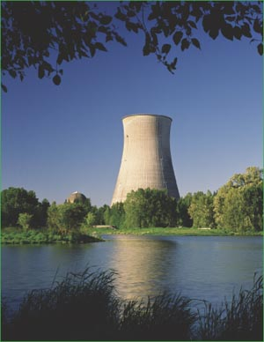
Nuclear Energy
There is a tremendous amount of energy found within atoms and there are special types of reactions that are unique to the nucleus of some atoms.
These reactions have been important throughout history and still are important today.

Slide 3
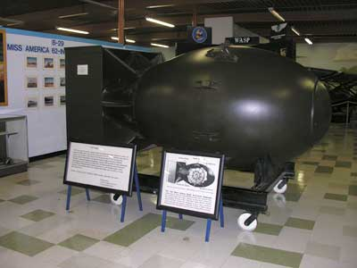
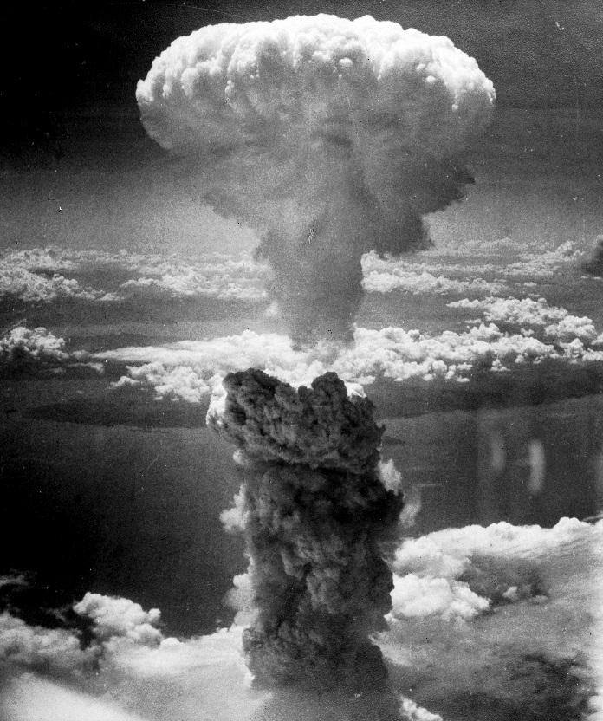
Some Nuclear Energy is Dangerous…. Like Using Atomic Bombs
Nuclear Bomb of 1945 known as “fat man” was dropped on the Japanese city of Nagasaki.
It along with “little boy” dropped on Hiroshima were the first time nuclear bombs were used in war.
Their destruction was nothing like the world had ever seen at the time!

Slide 4
What would that do today?

Slide 5
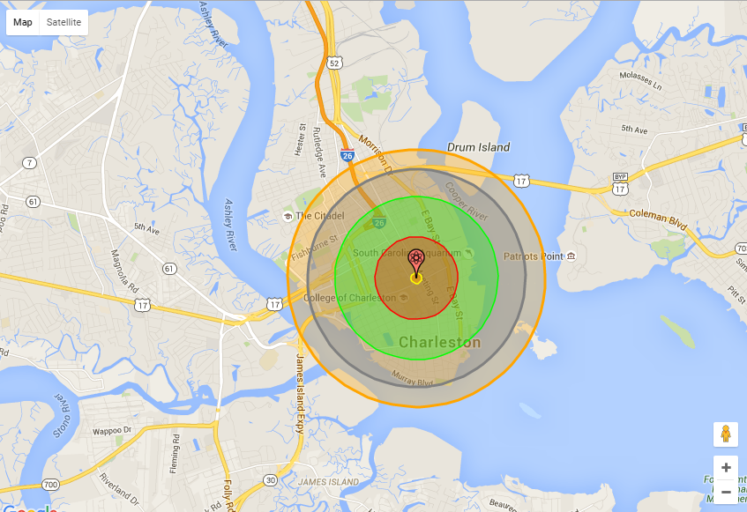
Red = 100 % building destruction Green = Lethal Radiation dose 90% Blue= Most building collapse Orange = 3rd degree burns to all exposed

Slide 6
Nuclear Energy
The energy from those bombs have to do with specific nuclear reactions.
We are going to explore those types of reactions as well as other nuclear reactions.

Slide 7
Time for you to Explore!

Slide 8
Radiation and Types of Decay

Slide 9
Stable vs Unstable Isotopes
If an isotope is stable, it will stay just as it is. There is no reason for it to change!
If an isotope is unstable, it will undergo a nuclear reaction in order to become stable.
These are nuclear reactions, not chemical reactions, so there are changes in the nucleus and not the electrons in the cloud.
Nuclear reactions produce approximately 500,000 times more energy than chemical reactions.

Slide 10
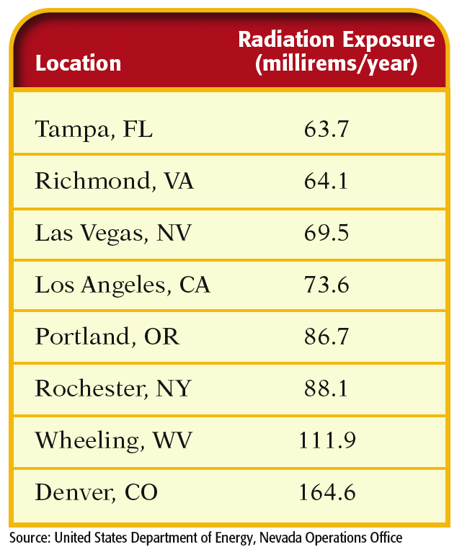
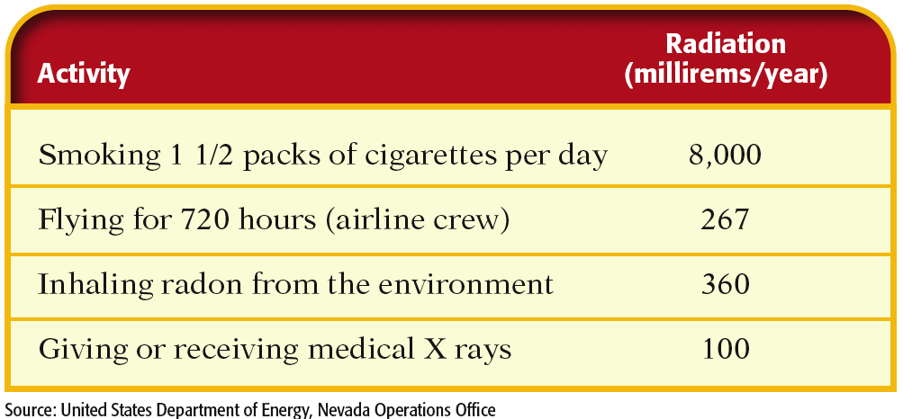
Where is radiation?
Exposure varies from one location to another.
Some activities add to the amount of nuclear radiation exposure.

Slide 11
Effects of Radiation
Rem or Rad is the biological effect of radiation
It is related to the strength of the radiation as well as the damage it causes

Slide 12
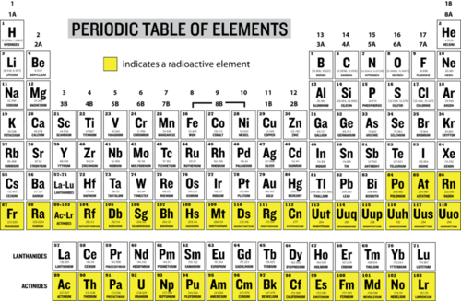
Is Everything Radioactive?
Isotopes 1-83 have both stable and unstable isotopes.
Elements 84 and above have ONLY unstable isotopes and at some point will decay until they reach stable configurations.

Slide 13
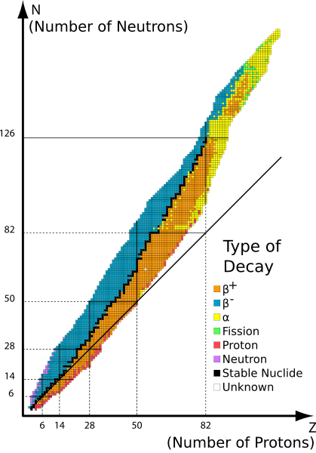
Band of Stability
The stability of an isotope depends on the Proton to Neutron ratio –
A) A 1:1 ratio of protons and neutrons is stable in lighter elements
Ex: C-12 is stable with 6 neutrons and 6 protons
B) A 1.5:1 or 3:2 ratio is stable in heavier elements,
Ex: Hg-202 is stable with 122 neutrons and 80 protons

Slide 14
3 Main Types of Radioactive Decay
Alpha α
Beta β
Gamma γ

Slide 15
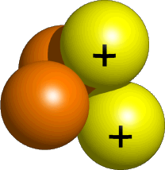
Alpha Decay
Emission of alpha particles α :
Helium nuclei
Made up of two protons and two neutrons
Charge +2
Can travel a few inches through air
Can be stopped by a sheet of paper, clothing.

Slide 16
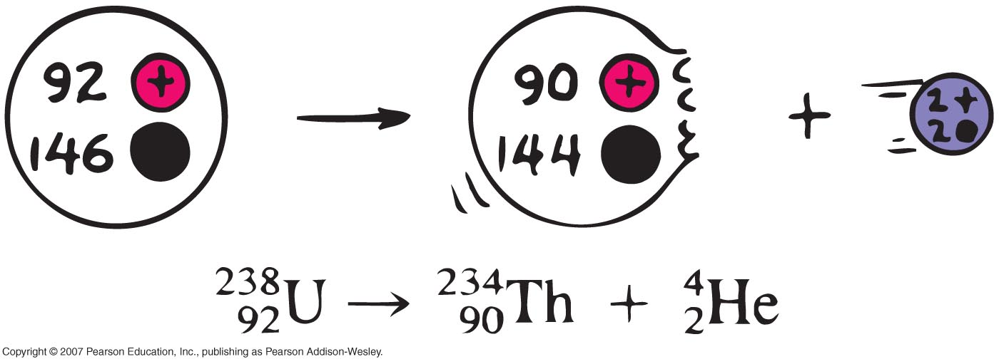
Alpha Decay
A
A - 4
4
X
Y
+
He
Z
Z - 2
2

Slide 17
Uses of Alpha Radiation
Smoke Detectors!
Americium-241 releases alpha particles into the air around it, creating an electric charge. When smoke gets in the way, the charge stops and the battery inside sends the alarm!
Cancer Treatment
Radium-223 can be placed directly in the middle of a tumor to kill the cancer cells. Because of the low-penetrating power, alpha particles can’t reach to the healthy cells!
Space Craft Heat and Electricity!
Plutonium-238 emits alpha particles and a bunch of heat, which keeps the spacecraft warm, and excess heat is turned into electricity to run the craft!

Slide 18
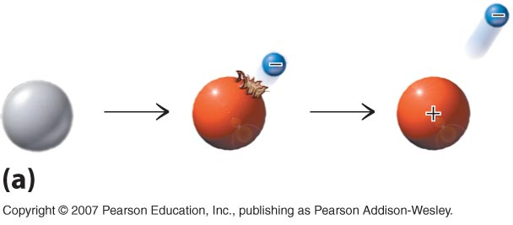
Beta Decay
Beta particles β: electrons ejected from the nucleus when a neutron decays into a proton.
Beta particles have the same charge and mass as "normal" electrons.
Are lighter, and can travel faster than alpha particles.
Can be stopped by aluminum foil or a block of wood.

Slide 19
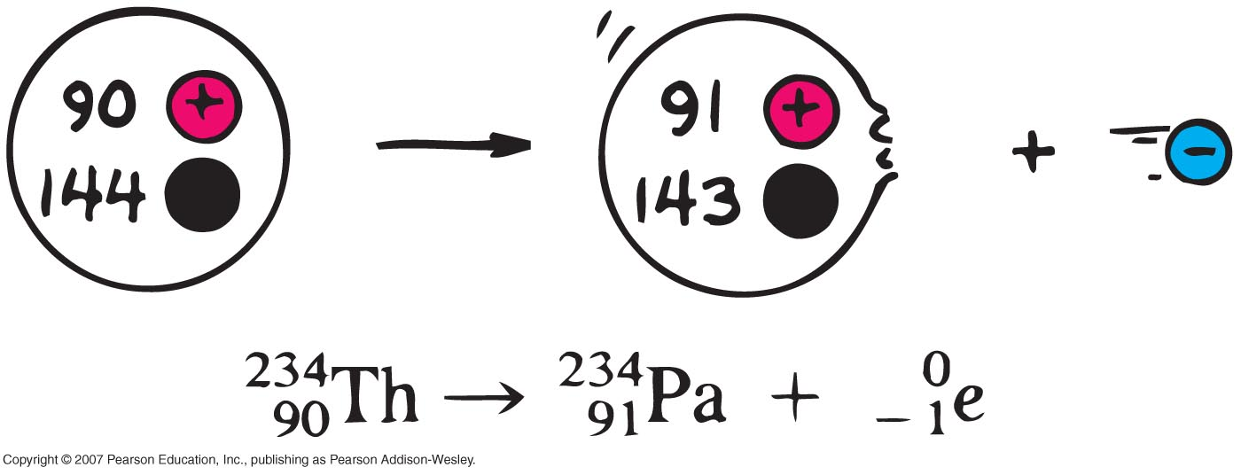
Beta Decay
A
X
A
Y
0
β
+
Z
Z+1
-1

Slide 20
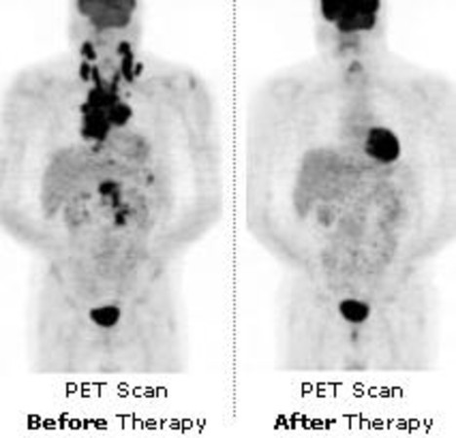
Beta Decay
PET Scans and other Tracers!
Short-lived radioactive elements are injected into your vein and allowed to travel through the body during PET Scans. A machine is then used to see where these atoms moved about through your body by detecting the beta particles! Can also be used in machinery or pipe systems to look for leaks or cracks!

Slide 21
Gamma Decay
Gamma radiation γ : electromagnetic energy that is released.
Gamma rays are electromagnetic waves that move at the speed of light.
They have no mass, but high energy!
Gamma radiation has no charge.
Most Penetrating, can be stopped by 1m thick concrete or a several cm thick sheet of lead or concerete.

Slide 22
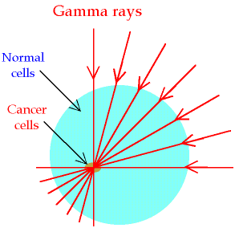
Uses of Gamma Radiation
Cancer Treatment!
Radium and Cobalt are often used to produce a consistent amount of high energy gamma rays. They can either be directed like a knife right at the tumor, or injected into the body where it targets cells that rapidly multiply!
Sterilize Equipment
Used to sterilize and kill any bacteria or germs from medical equipment and also sterilize packaged foods.

Slide 23
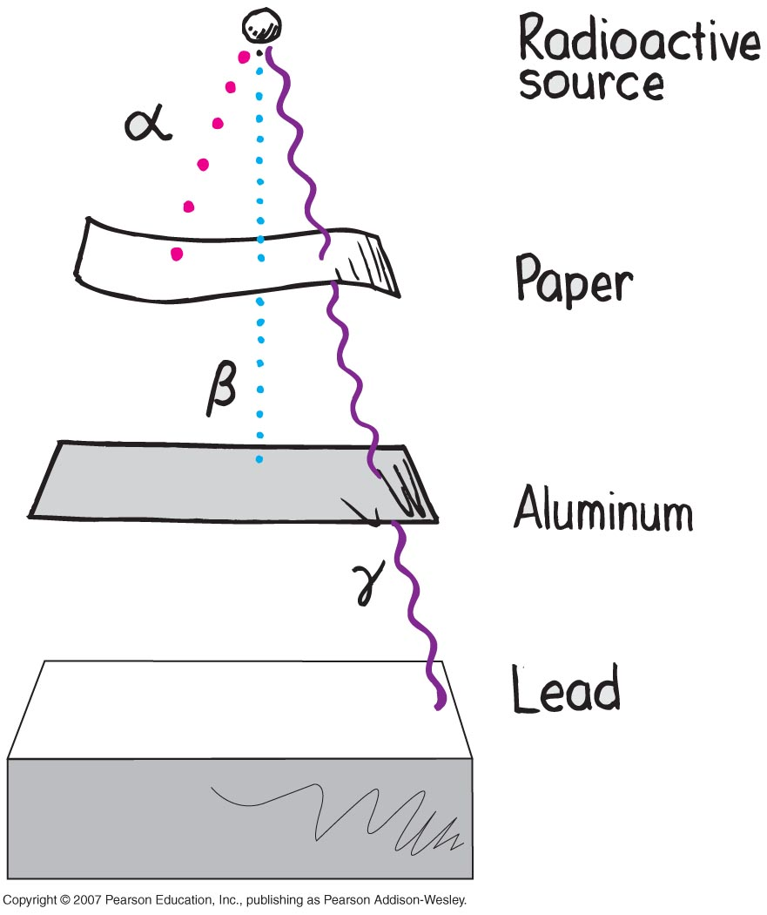

Slide 24
HONORS: Rules for Nuclear Reactions
Two parts to every reaction:
Reactants Products
Starting materials → Ending materials
Means a reaction has happened
Laws of Conservation: Certain properties are maintained throughout any reaction, nuclear or chemical
- charge
- mass and mass numbers
- we just talked about how this isn’t exactly true, but the mass change is small enough that it won’t affect what we’re doing here

Slide 25
HONORS: Balancing nuclear reactions
We can predict the type of radiation or the resulting atom of a nuclear reaction if we know enough information.
Ex: ²³⁹₉₄Pu + ⁴₂He → ¹₀n + _______
What kind of particle is this?
What do you think this is?

Slide 26
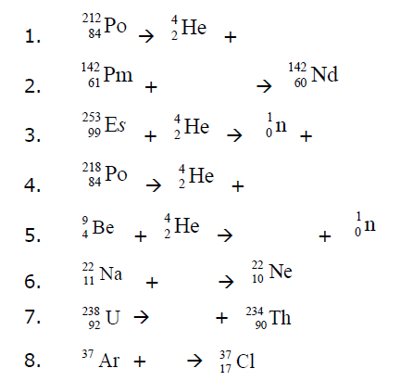
Options:
Alpha: ⁴₂He or ⁴₂α
Beta: ⁰₋₁e or ⁰₋₁β
Proton: ¹₁p or ¹₁H
Neutron: ¹₀n
Gamma: ⁰₀γ or γ

Slide 27
What’s the point of natural Nuclear reactions?
Trying to reach a STABLE nucleus! (at least to lead, Pb)
This often doesn’t happen with one reaction! Let’s take a look at the process at which radium-226 goes through to become stable…

Slide 28
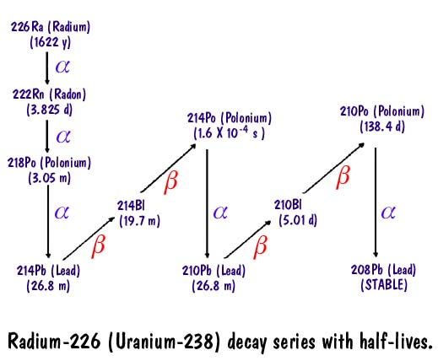
What 2 things are changing with each alpha decay?
What 1 thing changes with each beta decay?

