Slide 1
Orbital Hybridization

Slide 2
Remember…
How are electrons arranged in orbitals?
What is the difference between electron pair geometry and molecular geometry?

Slide 3
Overlapping Orbitals
Covalent bonds form when the unpaired electrons from one nonmetal atom become attracted to the nucleus of the another.
For example: Hydrogen has an unpaired electron in the 1s orbital and Fluorine has an unpaired electron in its 2p sublevel.
Hydrogen Orbital Diagram
Fluorine Orbital Diagram

Slide 4
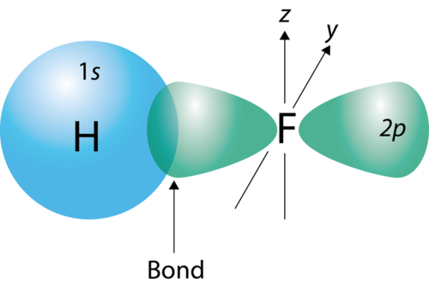
Valence Bond Theory
When they bond, the 2p orbital from fluorine and the 1s orbital from hydrogen will overlap and produce the H-F covalent bond.
This illustrates the valence bond theory which states that covalent bonds are formed by the overlap of partially filled atomic orbitals

Slide 5
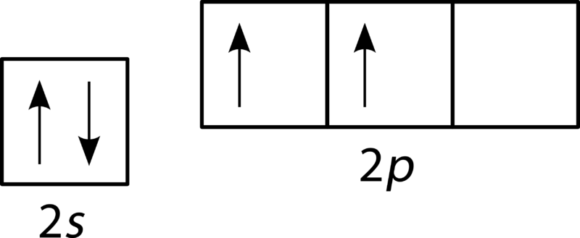
Hybrid Orbitals
Sometimes, overlap of s or p orbitals individually does not explain some of the bonds and shapes that are formed through covalent bonding.
For example: Draw the orbital diagram for carbon.
According the valence bond theory, carbon would be expected to form only two bonds, we know this is not usually true for carbon

Slide 6
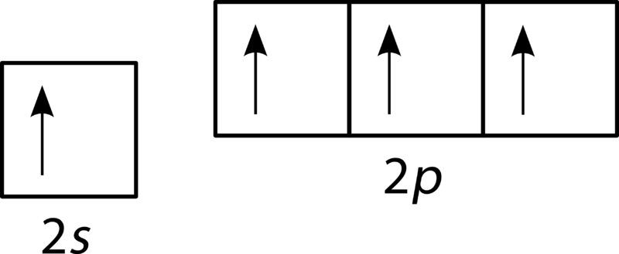
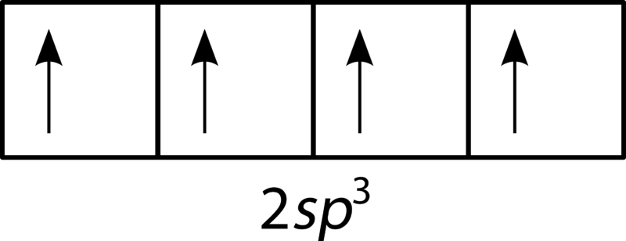
Hybrid Orbitals
Think about the molecule methane, how many bonds does carbon actually form?
One way to account for this is to promote one of the 2s electrons up the 2p orbital.
Now, there are 4 unpaired electrons and 4 possible bonding regions
This is what we call hybridization and the new orbital that has been formed is referred to as an sp³ orbital

Slide 7
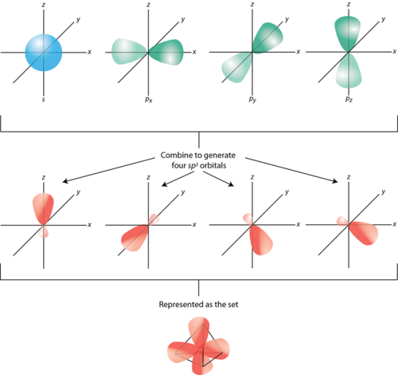

Slide 8
Hybridization
Hybridization is the mixing of atomic orbitals to produce a new orbital that is a combination of other orbitals.
Hybrid orbitals are formed when two or more different orbitals combine for the purpose of bond formation.

