Slide 1
Thermochemistry
Specific Heat

Slide 2
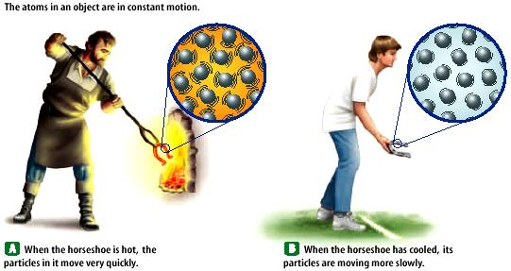
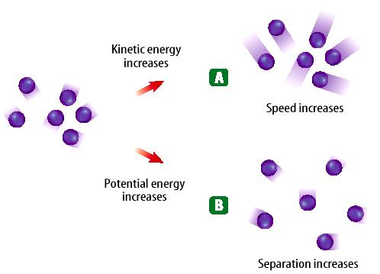
Temperature is the measurement of the average kinetic energy of the particles in a substance. The SI unit for temperature is the Kelvin. a. K = C + 273 (10 C = 283 K) b. C = K – 273 (10 K = -263 C)
Heat is energy in transit. It depends on the total energy, not just the average kinetic energy. substance.

Slide 3
Specific Heat
Specific heat….
is the amount of heat energy required to raise the temperature of 1.0 g of a substance by 1.0 °C
is different for different substances
has units of J/g °C
in the metric system has units of cal/g °C

Slide 4
Units for Energy
The SI unit for energy is the Joule. English units for energy include the unit calories.
1000 calories (little c) are in one Calorie (Big C), which is used to measure the energy in foods (that the human body can make use of).
4.186 J = 1 cal 1000 cal = 1 Calorie

Slide 5
Have you ever been super hot at the beach, only to run down to the water and realize it is so cold? How can this be?
Why does the land heat up faster and cool down quicker than the water?
Sand =
664 J / kg C
Water = 4184 J / kg C

Slide 6
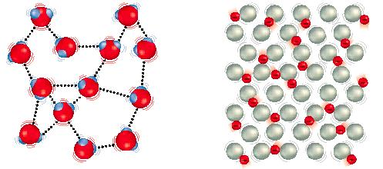
Why do materials have different specific heats?
water metal
Water molecules form strong bonds with each other;(hydrogen bonding), therefore it takes more heat energy to break the molecules apart.
Metals have weaker bonds (metallic – electron sea model) and do not need as much energy to break the metal atoms apart.

Slide 7
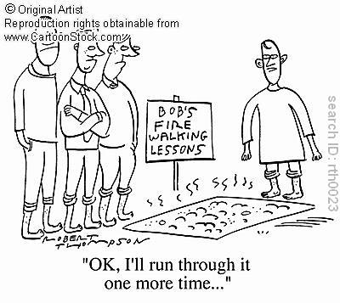
Heat Transfer
Share with your partner: How can people walk on hot coals?
Fire Walkers!

Slide 8
But if heat is indeed transferred from the hot coals to the fire-walkers’ feet, then why don’t they burn their feet?
Share your thoughts with your partner!
Different substances can transfer the same amount of heat at differing rates.
The amount of energy required to raise the temperature of one gram of a substance by one degree Celsius is known as the Specific Heat Capacity (S)
Different substances = different heating ability

Slide 9
Learning Check
1. If the same amount of heat is added to two different substances, the one with a large specific heat….
A) has a smaller increase in temperature
B) has a greater increase in temperature
2. When ocean water cools, the surrounding air
A) cools B) warms C) stays the same
3. Sand in the desert is hot in the day and cool
at night. Sand must have a
A) high specific heat B) low specific heat

Slide 10
Learning Check Solution
1. For the same amount of heat added, a substance with a large specific heat
A) has a smaller increase in temperature
2. When ocean water cools, the surrounding air
B) warms
3. Sand in the desert is hot in the day and cool at night. Sand must have a
B) low specific heat

Slide 11
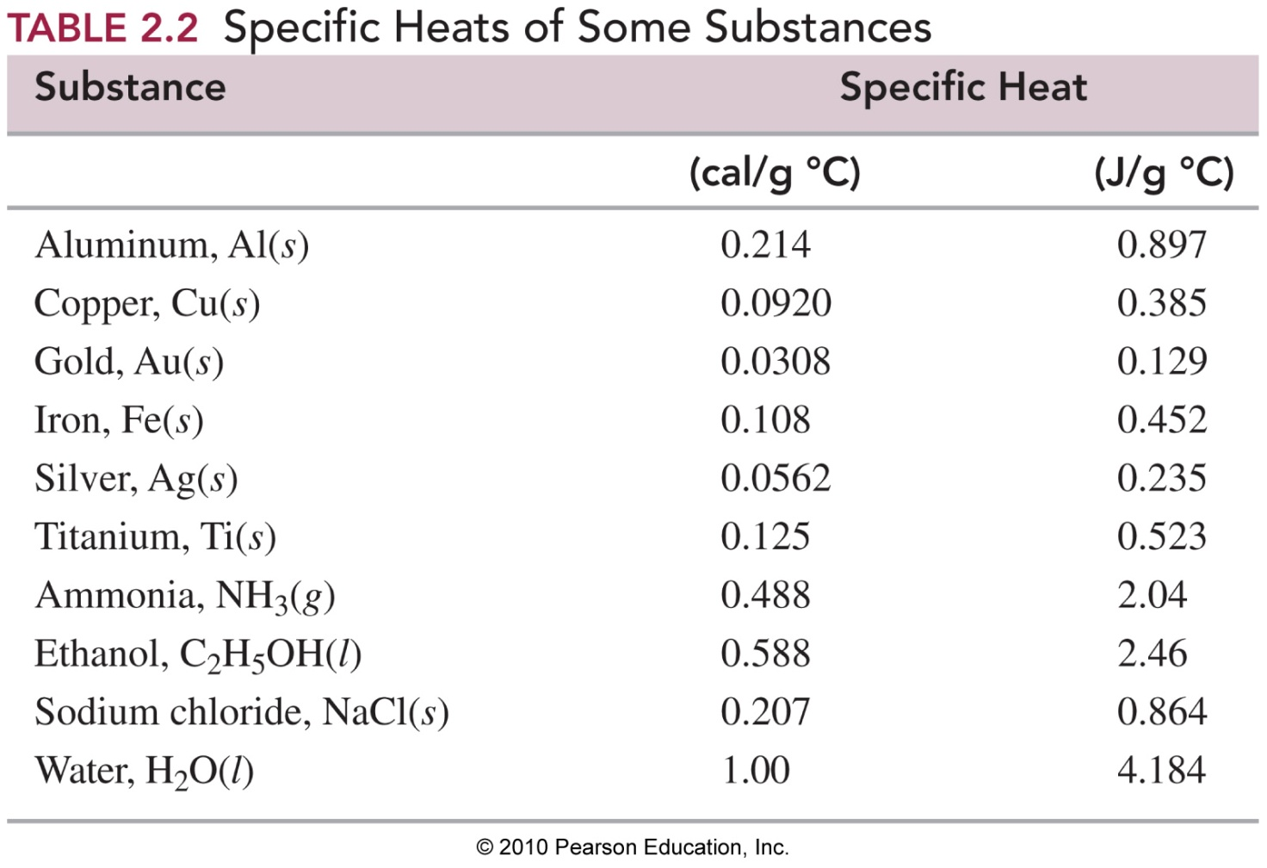
Examples of Specific Heats

Slide 12
Specific Heat Equation
Q = S_{(p)}mT
q = Change in (heat) Energy (unit: Joules)
m = mass of substance (unit: grams)
S = specific heat of substance (unit J/g⋅ ̊C) (p) = what phase the material is in
T = change in temperature (Tf – Ti) (unit ̊C)

Slide 13
■ Calculating Heat with Temperature Increase
How many joules are absorbed by 45.2 g of aluminum if its temperature rises from 12.5 °C to 76.8 °C? (The specific heat of Aluminum is 0.897 J/gºC
Given: Mass = 45.2 g
Specific heat (S) for aluminum = 0.897 J/g °C
Initial temperature = 12.5 °C
Final temperature = 76.8 °C
Need: Heat (q) in joules (J)

Slide 14
■ Calculating Heat Loss
A 225-g sample of hot tea cools from 74.6 °C to 22.4 °C. How much heat (in kilojoules) is lost, assuming that tea has the same specific heat as water?
Given: Mass = 225 g Specific Heat (S) for tea = 4.184 J/g °C
Initial temperature = 74.6 °C Final temperature = 22.4 °C
Need heat (q) in kilojoules (kJ)

Slide 15
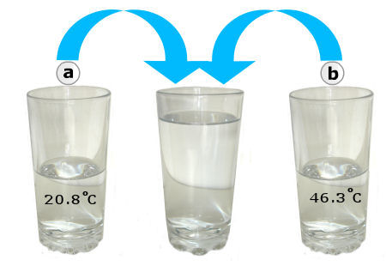
If the 2 cups are mixed, approximately what would you expect the resulting temperature to be assuming no heat is lost to the environment?
In thermal equilibrium, we would expect the hot substance to transfer heat to the cold substance until they come to the same temperature.
Notes:
Since heat can not be created or destroyed, systems must come to thermal equilibrium where heat will dissipate inside a system

Slide 16
Thermal Equilibrium
If a hot stone is put inside a thermos with an ice cube, what would you expect to happen?
Notes:
In the initial state, the heated stone and the lump of ice are in the insulating container. During the process of approaching to thermal equilibrium, heat will transfer through the air from the heated stone to the lump of ice, and the lump of ice will be melting into water. Eventually, this closed system will achieve thermal equilibrium.

Slide 17
Can We Predict that Temp?
Calorimetry: the measurement of heat
Calorimeter: the heat measuring device.
The calorimeter is generally used to measure the amount of heat energy transferred from one object to another during a reaction.

Slide 18
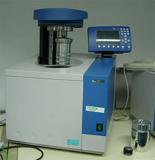
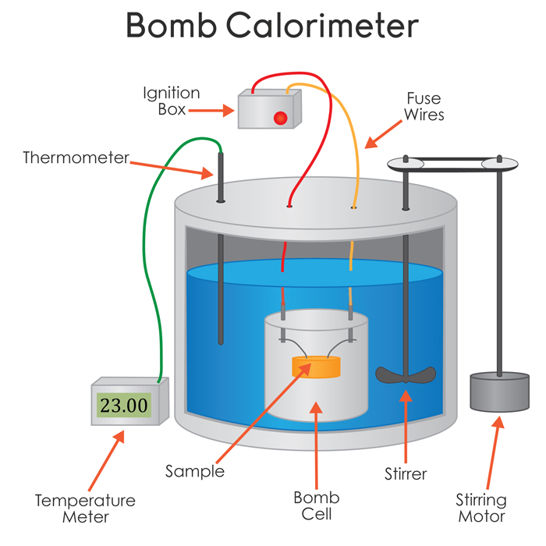
Bomb Calorimeter

Slide 19
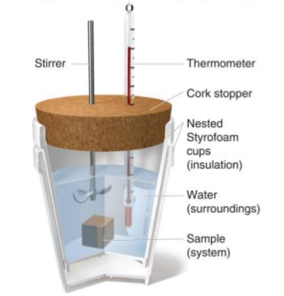
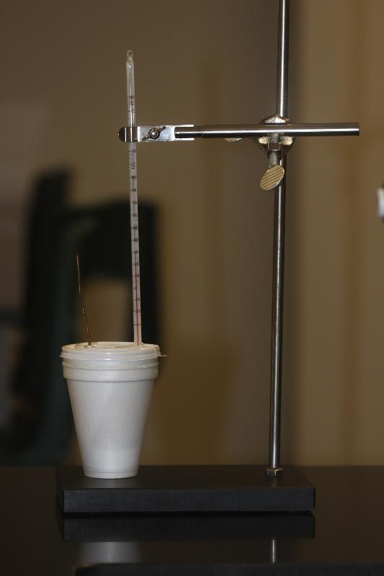
Coffee Cup Calorimeters
Notes:
Closed System

Slide 20
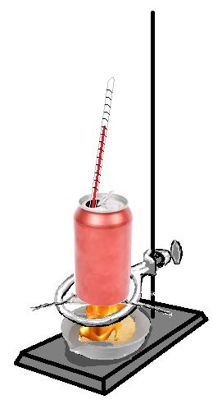
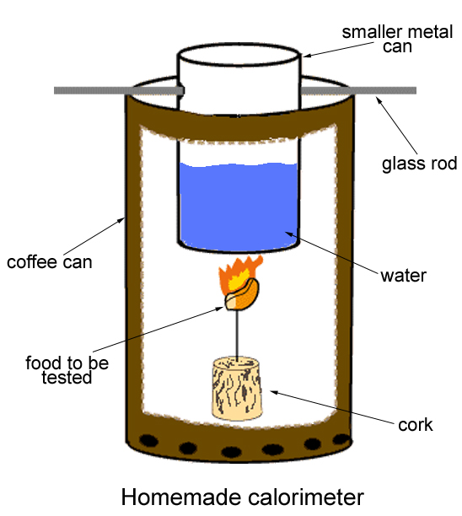
Homemade Calorimeter

Slide 21
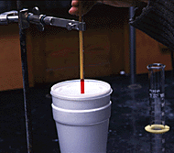
Calorimeter
A closed system in which energy is maintained until substances reach thermal equilibrium.
-(q ₁) = q ₂
Substance that loses heat energy
Substance that gains heat energy

Slide 22
Calculating Thermal Equilibrium
-(q ₁) = q ₂
Substance that releases heat energy
Substance that absorbs heat energy
-(mSΔT)₁ = (mSΔT)₂

Slide 23
A sample of aluminum (0.895 J/g °C )at 75.0°C was placed in a calorimeter containing 25.0 grams of water at 20.0°C. The temperature stopped changing at 29.4°C. What is the mass of the aluminum sample?
-(Q ₁) = Q ₂
-(S_{metal}m_{metal}∆T_{metal} )= S_{water}m_{water}∆T_{water}
-[(0.895 J/gC)(mass)(29.4C-75C)] = (4.184 J/gC)(25.0g)(29.4C-20.0C)
24 grams of aluminum

Slide 24
A 4.57 g sample of metal is heated to 57.8 ̊C and placed in 150. mL of water that is at 20.0 ̊C. The temperature of the water increases to 40.0 ̊C. What is the specific heat capacity of the metal?
-(Q ₁) = Q ₂
-(S_{metal}m_{metal}∆T_{metal} )= S_{water}m_{water}∆T_{water}

Slide 25
A 8.13 g sample of iron is heated to 45.4 ̊C and placed in 400. mL of water that is at 23.0 ̊C. What will the final temperature?
-(Q ₁) = Q ₂
-(S_{metal}m_{metal} (T_{final system}-T_{initial metal}))= S_{water}m_{water} (T_{final system}-T_{initial water}))=
THERMAL EQUILIBRIUM

