Slide 1
Gas Notes: Combined Gas Law

Slide 2
Hey chem students…. Watch this!
Tanker Scenario

Slide 3
About the Tanker…
Before the tanker imploded, the interior was washed with 120ºC steam, and then it was sealed.
Talk with your table partner….
What happened to the gas inside?

Slide 4
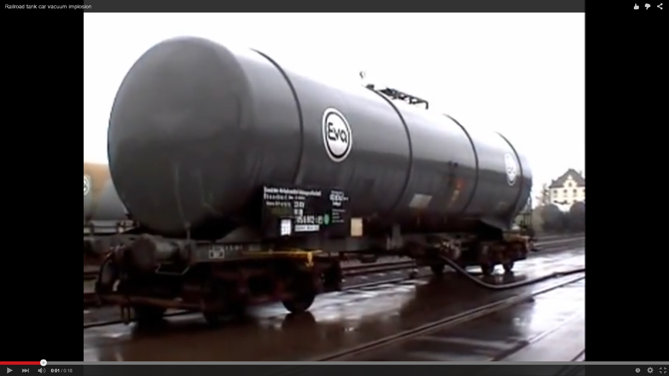
Review: Ideal Gas Law Calculations
If 1500 moles of gas is contained in this sealed 44,000 L tanker and it has been steam washed at 120ºC, what is the pressure of the tanker?

Slide 5
Ideal Gas Law Calculations
If 1500 moles of gas is contained in this sealed 44,000 L tanker and it has been steam washed at 120ºC, what is the pressure of the tanker?
Remember the steps:
Step 1: Identify your given information and see what you have to find.
Step 2: Do you have to do any conversions before you use PV = nRT?
Step 3: Rearrange the equation and plug in the information!
PV = nRT R = 0.08206 $\frac{L ∙ atm}{mol ∙ K}$

Slide 6
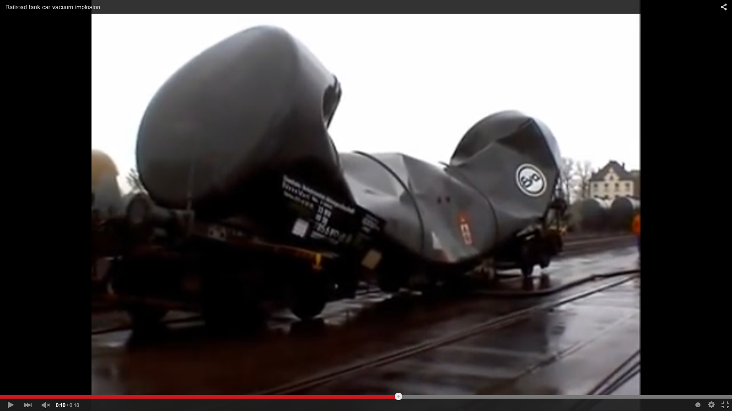
So… How about now?
If the tanker has cooled to a temperature of 20ºC, what is the pressure of the tanker causing it to implode?
Notes:
We can assume that the volume is constant because the container was sealed. We can also assume that the amount of moles is constant.

Slide 7
Double double toil and trouble… With Double PV=nRT of course!
$$\frac{P_{1}V_{1}}{P_{2}V_{2}}=\frac{n_{1}R_{1}T_{1}}{n_{2}R_{2}T_{2}}$$
Initial Conditions
Final Conditions

Slide 8
Tanker Calculations using double PV=nRT
If the tanker has cooled to a temperature of 20ºC, what is the pressure of the tanker causing it to implode?
Step 1: Identify your given information and see what you have to find.
Given Information:
Initial Conditions
P = 1.2 atm
V = 2.5 L
T = 25ºC
n = 1500 moles
Final Conditions
V =
T =
n =
Find: Final Pressure!

Slide 9
Tanker Calculations using double PV=nRT
If the tanker has cooled to a temperature of 20ºC, what is the pressure of the tanker causing it to implode?
Step 2: Do you have to do any conversions before you use PV = nRT?
Yes! Temperature must be in Kelvin.
T₁ = 120 + 273.15
T₁ = 398. 15 K
T₂ = 20 + 273.15
T₂ = 298.15 K

Slide 10
Tanker Calculations using double PV=nRT
If the tanker has cooled to a temperature of 20ºC, what is the pressure of the tanker causing it to implode?
Step 3: Rearrange and plug it in!
$$\frac{P_{1}V_{1}}{P_{2}V_{2}}=\frac{n_{1}R_{1}T_{1}}{n_{2}R_{2}T_{2}}$$
$$\frac{P_{1}V_{1}}{P_{2}V_{2}}=\frac{n_{1}R_{1}T_{1}}{n_{2}R_{2}T_{2}}$$

Slide 11
Tanker Calculations using double PV=nRT
If the tanker has cooled to a temperature of 20ºC, what is the pressure of the tanker causing it to implode?
Step 3: Rearrange and plug it in!
$$\frac{P_{1}}{P_{2}}=\frac{T_{1}}{T_{2}}$$
$$\frac{P_{1}T_{2}}{T_{1}}=P_{2}$$

Slide 12
Tanker Calculations using double PV=nRT
If the tanker has cooled to a temperature of 20ºC, what is the pressure of the tanker causing it to implode?
Step 3: Rearrange and plug it in!
$$\frac{P_{1}T_{2}}{T_{1}}=P_{2}$$
$$\frac{\left(1.1 atm\right)\left(298.15 K\right)}{(398.15 K)}= P_{2}$$

Slide 13
Your Turn: Practice using double PV=nRT (Combined Gas Law)
Remember the steps:
Step 1: Identify your given information and see what you have to find.
Step 2: Do you have to do any conversions before you use PV = nRT?
Step 3: Rearrange the equation and plug in the information!

