Slide 1
Chemical Process
Dissolve, Dissociate, Ionize, Precipitate

Slide 2
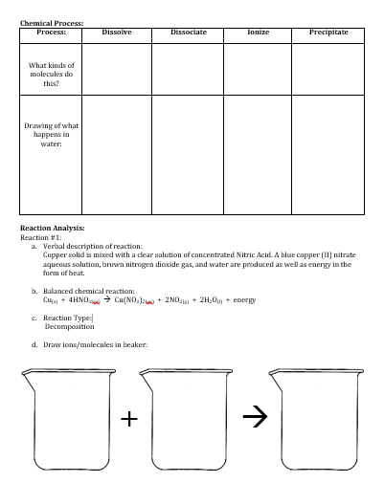
What do you need for this lesson?
Pencil
Copper Cycle Lab
Turn to this page! You are going to take notes in this grid and work to complete the reaction analysis using the information in this powerpoint.

Slide 3
What is a Chemical Process?
Most chemical reactions occur when substances are in water.
There are 4 processes that can occur when a substance makes contact with water:
Dissolve
Dissociate
Ionize
Precipitate

Slide 4
Dissolve
What is this process? | What compounds do this?
When the forces that hold molecules together (intermolecular forces) are broken. | Polar Covalent Molecules Ionic Compounds Acids

Slide 5
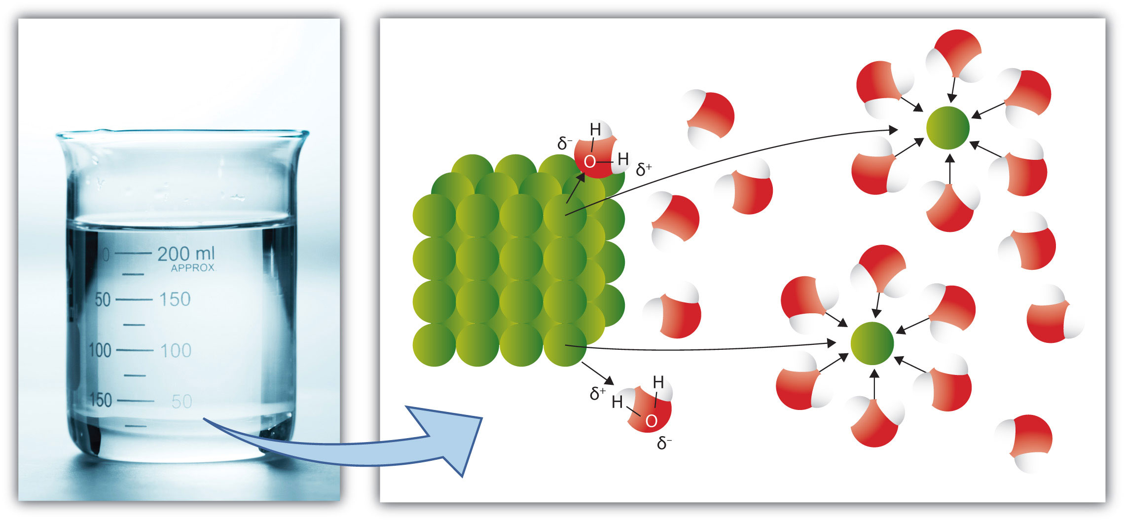
What does dissolving look like?
Here is an example of a sugar cube in water (the sugar cube is green, the water molecules are red and white—the red is the oxygen and the white is the hydrogen). Sugar is a polar covalent molecule, so it dissolves in water (remember “like dissolves like”). The water molecules are pulling the individual sugar molecules away from the cube, dissolving the sugar cube.

Slide 6
Dissociate
What is this process? | What compounds do this?
When the ionic chemical bonds that hold ions together are broken. | Soluble ionic compounds

Slide 7
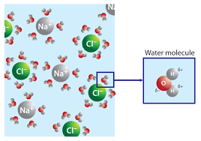
What does dissociating look like?
Here is an example of a salt (NaCl) crystal in water. Salt is an ionic compound so it dissolves and dissociates. The water molecules are pulling the individual salt molecules away from each other (dissolving) and then are breaking the chemical bonds that hold together the salt compounds (dissociating).

Slide 8
Which ionic compounds dissociate?
SOLUBLE COMPOUNDS (dissociate in H₂O) | EXCEPTIONS
Salts of Na⁺, K⁺ and NH₄⁺ | none
Chlorides (Cl⁻), Bromides (Br⁻), and Iodides (I⁻) [Called Halide Salts (the Halogens)] | Ag⁺, Hg₂⁺², Pb⁺²
Compounds containing Fluoride (F⁻) | Mg⁺², Ca⁺², Sr⁺², Ba⁺², Pb⁺²
Nitrates (NO₃⁻), Chlorates (ClO₃⁻), Perchlorates, (ClO₄⁻), Acetates (C₂H₃O₂⁻) | AgC₂H₃O₂ and Hg₂(C₂H₃O₂) ₂
Sulfates (SO₄-²) | Sr⁺², Ba⁺², Pb⁺², Ca⁺², Ag⁺¹

Slide 9
Ionize
What is this process? | What compounds do this?
When the polar covalent chemical bonds are broken and a substance is converted into ions | Acids

Slide 10
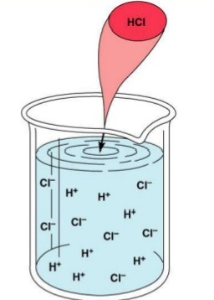
What does ionizing look like?
Here is an example of an acid (HCl) in water. Hydrochloric acid is a polar covalent molecule, so it dissolves in water (remember “like dissolves like”). The water molecules are pulling the individual acid molecules away from the each other (dissolving), and then are breaking the chemical bonds creating ions from a substance that didn’t previous have ions (ionizing).

Slide 11
Precipitate
What is this process? | What compounds do this?
When two insoluble ions form a solid. | Insoluble Ionic Compounds

Slide 12
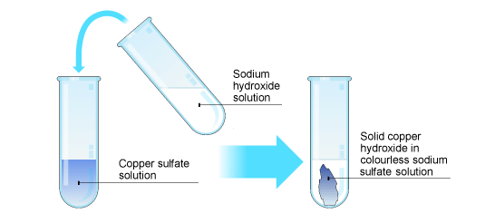
What does precipitating look like?
Here is an example of two solutions mixing to form a precipitate. Both Copper (II) Sulfate and Sodium Hydroxide are aqueous solutions (both compounds dissolve and dissociate in water). When mixed, the Cu⁺² ions join with the OH⁻¹ ions and become insoluble, meaning that they do not dissolve in water. When they join together, they form a solid compound, called a precipitate.

Slide 13
Which ionic compounds precipitate?
INSOLUBLE (precipitate in H₂O) | EXCEPTIONS
All carbonates (CO₃⁻²), Phosphates (PO₄⁻³), Chromates (CrO₄⁻²), Oxalates (C₂O₄⁻²) | Na⁺, K⁺, NH₄⁺
All sulfides (S⁻²) | Group 1 and 2 cations and NH₄⁺
8. All hydroxides (OH⁻) and oxides (O⁻²) | Group 1 and NH₄⁺

Slide 14
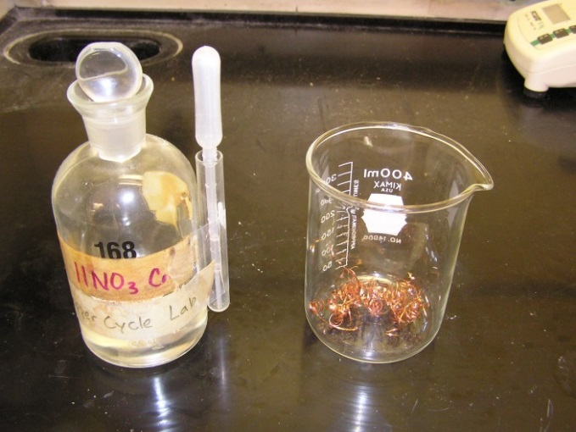
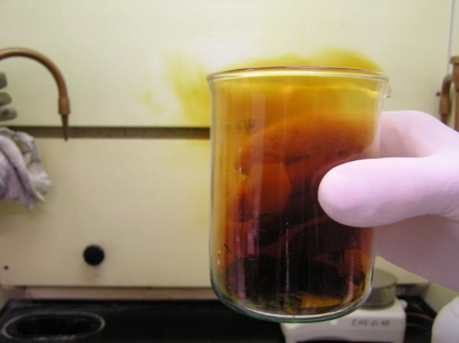
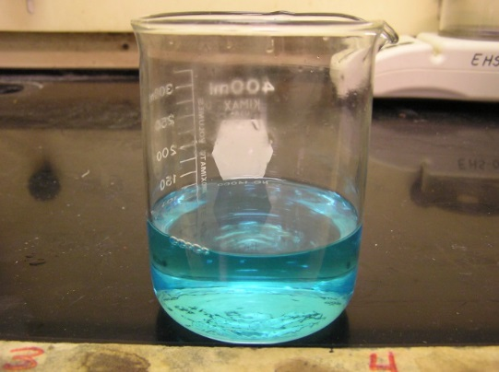
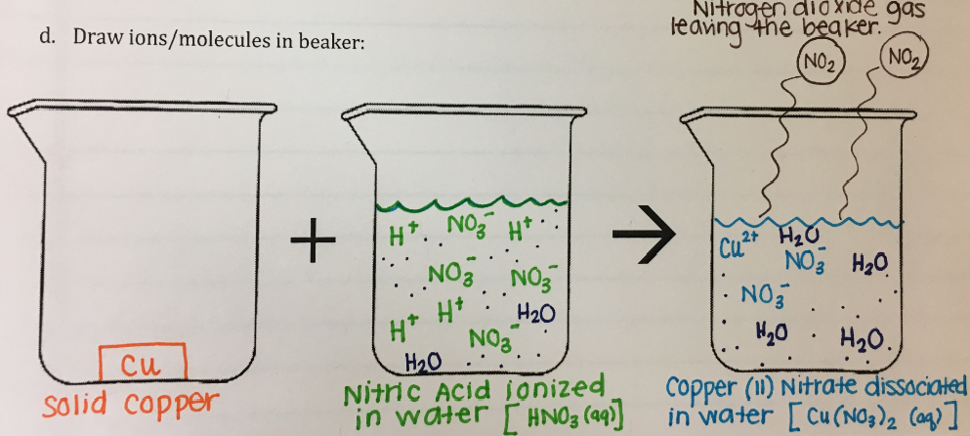
Reaction Analysis of Copper Cycle Lab
Day 1 Reaction #1
You can copy this into your lab. Use what you see to complete the Reaction Analysis for every reaction in the lab.
→

