Slide 1
Types of Reactions

Slide 2
6 Types of Chemical Reactions
All chemical reactions can be described in terms of something moving. The 6 Types of reactions are classified as follows:
Movement of Electrons:
Addition
Decomposition
Single Displacement
Combustion
Movement of Ions:
Double Displacement
Movement of Protons:
Acid-Base

Slide 3
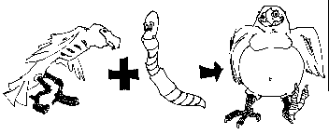
Synthesis (Addition)
Two or more substances combine to form a new compound
Happens because of a movement of electrons
There is only ONE PRODUCT!
A + B → AB
Example: Fe + O₂→ Fe₂O₃

Slide 4
Addition (Synthesis)

Slide 5
Decomposition
Compounds are broken down into two or more smaller compounds
Happens because of a movement of electrons
There is only ONE REACTANT!
AB → A + B
Example: SiCl₄ → Si + Cl₂

Slide 6
Decomposition

Slide 7
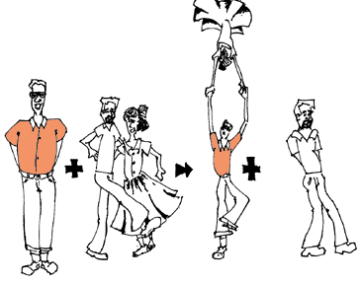
Single Displacement
One element replaces another in a compound
Happens because of a movement of electrons
There is a SINGLE element on both sides of the reactions.
AX + B → BX + A
Example: Ca + HCl → CaCl₂ + H₂

Slide 8
Single Displacement

Slide 9
Combustion
Carbon compound combines with oxygen to release carbon dioxide and water and energy
Happens because of a movement of electrons
The products are ALWAYS CO₂ and H₂O
Hydrocarbon + O₂→ CO₂ + H₂0 + energy!
Example: C₂H₆ + O₂→ CO₂ + H₂O
But don’t forget that ENERY is a product too (heat, light, etc)…

Slide 10
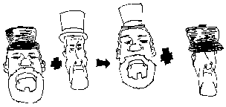
Double Displacement
Ions switch bonding partners
Happens because of a movement of ions
AB + CD → AD + CB
Example: AgNO₃ + NaCl → AgCl + NaNO₃

Slide 11
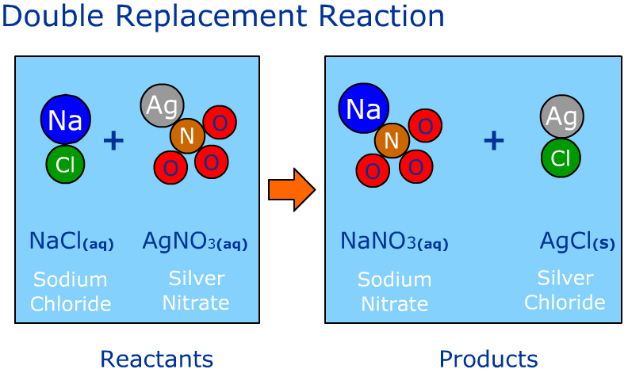
Double Displacement

Slide 12
Acid-Base Reaction
This is a sub-class of a double displacement reaction
Happens because of a movement of protons (H⁺)
The products are ALWAYS H₂O and a salt
AB + CD → Salt + H₂O
Example: HCl + NaOH → NaCl + H₂O
SALT WATER
*This is for an acid and a base that are equal strength only.

Slide 13
Reaction Recap
Addition
- End with only 1 compound
Decomposition
– Start with only 1 compound
Single Displacement
- Each side has a single element and a compound
Combustion
- Products will always be CO₂ + H₂O and ENERGY
Double Displacement
- Each side has 2 compounds
Acid-Base Reaction
- Products will always be H₂O and a salt (ionic compound) of some form

