Slide 1
Scientific Notation and Significant Figures

Slide 2
Scientific Notation
Why Scientific Notation?
Scientists sometimes have to deal in very large or very small quantities, and scientific notation is a way of expressing that number.
Remember the Power of 10?
The Power of 10 Video

Slide 3
How To: Scientific Notation
Rules to Follow:
A positive exponent indicates that the number is greater than 1.
Example:
1,500,000.0 = 1.5 x 10⁶
A negative exponent indicates that the number is less than 1.
Example:
0.000025 = 2.5 x 10⁻⁵
Scientific Notation: Coefficient must be between 1 and 9
Standard Notation

Slide 4
Scientific Notation Practice!
Complete the rest with a partner!
Convert the following to scientific notation:
0.005
5,050
0.0008
1,000.
1,000,000
5 x 10⁻³
5.05 x 10³
8 x 10⁻⁴
1.000 x 10³
1 x 10⁶
Notes:
5 x 10^-3
5.05 x 10^3
8 x 10^-3
1 x 10^3
1 x 10^6

Slide 5
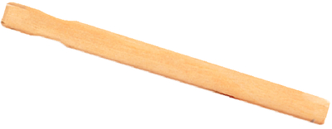
Measuring with a “Glug”
This is a “Glug.” Seriously. That’s its name.
Today we’re going to measure with it.

Slide 6
Measuring with a “Glug”
Introduce yourself to your group!
Your group will get ONE Glug and a file folder.
Open up the file folder and measure the length and the width with your Glug.
Calculate the area of the file folder.
SHOW ALL OF YOUR WORK ON THE WHITE BOARD!
Record your final area at the front of the room.
Area = Length x Width

Slide 7
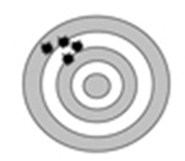
Accuracy and Precision
Accuracy: When an measurement of an object is taken and is very close to the true value of that object.
Precision: When several measurements are taken and are all very similar to one another.

Slide 8
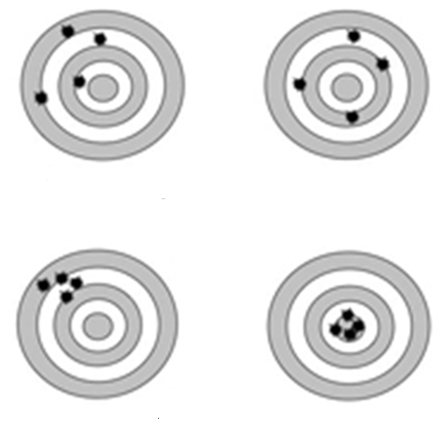
Accuracy and Precision
Label these four targets:
Accurate/Precise
Accurate/Not Precise
Not accurate/Precise
Not accurate/Not Precise

Slide 9
Taking Measurements
When taking measurements, you always use the device’s limit of precision.
This means that you always measure one value place past what the device measures to.
cm

Slide 10
So…. What about the “Glug”?
What is the limit of precision for this instrument?

Slide 11
Do all numbers matter?
Not all numbers in a value are “significant.”
Significant figures show the accuracy and precision of a measurement.
How many mL are in this graduated cylinder?
Reading at the meniscus

Slide 12
Counting Significant Figures
4 Rules to Remember:
Non-zero Numbers are ALWAYS Significant
Sandwiched Zeros are ALWAYS Significant
Leading Zeros are NEVER Significant
Trailing Zeros are SOMETIMES Significant

Slide 13
NON-ZERO NUMBERS
Value Sig Figs
8 mm 1
42 lbs ?
678 mm ?
9 lbs ?

Slide 14
SANDWICHED ZEROS
Value Sig Figs
50.8 mm 3
2001 min 4
0.702 lb ?
0.00405 m ?

Slide 15
LEADING ZEROS
Value Sig Figs
0.008 mm 1
0.0156 oz 3
0.0042 lb ?
0.000262 mL ?

Slide 16
TRAILING ZEROS
When a decimal is PRESENT: Trailing Zeros ARE Significant
When a decimal is ABSENT: Trailing Zeros are NOT Signficiant
Value Sig Figs
25,000 in. 2
200. yr 3
48,600 gal ?
25,005,000. g ?

Slide 17
Practicing!
Complete the rest of Page 2 and Page 3
Done early?
Plug in your headphones to your smartphone and start on your homework!

Slide 18
Calculations Using Sig Figs
There are different rules for different mathematical operations:
RULE: When adding and subtracting the answer is limited not by the significant digits, but the limit of precision!
Example:
123.25 mL + 46.0 mL + 86.257 mL =
The calculated answer is 255.507 mL
The reported answer is rounded to the tenths place because 46.0 mL has the lowest limit of precision (least amount of decimal places).
The answer is 255.5 mL

Slide 19
Calculations Using Sig Figs
There are different rules for different mathematical operations:
RULE: When multiplying and dividing the answer has the same number of significant digits as the value with the fewest.
Example:
23.0 cm x 432 cm x 19 cm =
The calculated answer is 188,784 cm³
The reported answer is rounded to two sig figs because 19 cm has the least amount in the problem.
The answer is 190,000 cm³

