Slide 1
Thermochemistry
Potential Energy Diagrams
Rates of Reactions

Slide 2
Enthalpy Changes
Chemists and scientists are most interested in the change of energy in a reaction, not necessarily how much total energy is left at the end. This is referred to as ΔH, or enthalpy.
Δ is the Greek letter “delta” and means “change”
H refers to “heat” or “energy”
Measured in kJ, or kilojoules (pronounced “kilo-jewels”)
You can have a ΔH for phase changes as well as chemical reactions, because heat can be transferred in BOTH.

Slide 3
Endothermic or Exothermic?
Endothermic means that heat/energy is gained or absorbed ………….so the ΔH would be positive This means a positive change in enthalpy
Examples: baking bread, cooking an egg, photosynthesis
Exothermic means that heat/energy is released or lost ………….so the ΔH would be negative This means a negative change in enthalpy
Examples: burning a candle, rusting iron, nuclear fission

Slide 4
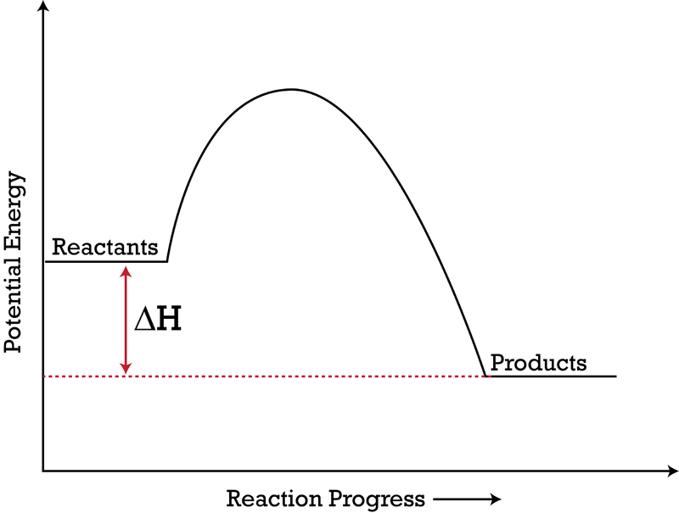
Energy Diagrams
We use energy diagrams to display the energy changes that need to occur for a reaction to happen
Would this be an endothermic or exothermic reaction?

Slide 5
Energy Diagrams
We group the reactants together and add together the energy from their bonds and make a line on the left side of the graph at this value
We do the same for the products and make a line on the right side of the graph
ΔH = enthalpy of products – enthalpy of reactants
Or, it is the difference of energy between the products and reactants

Slide 6
The Transition State (Activated Complex)
During a chemical reaction, the atoms of the reactants recombine and rearrange to form the products, but this doesn’t happen instantly.
The reactants form a Transition State which is a temporary and unstable form where all of the atoms are partially connected as old bonds start to break and new bonds start to form
This can also be called the Activated Complex

Slide 7
Activation Energy
Every reaction needs at least some energy to form this transition state and get the reaction started
Sometimes this is very low and room temperature is enough to get it started
Sometimes this is very high and takes extremely high temperatures like a furnace to get started
This is called the Activation Energy and is given the symbol E_{a} (for energy of activation)
E_{a}

Slide 8
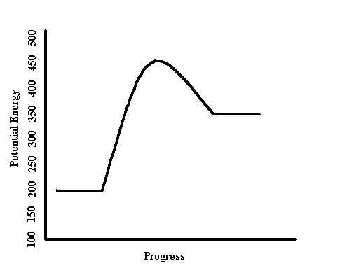
Learning Check
Where are the reactants, products, and transition state? What are their energies?
What is the E_{a} and ΔH (approximately)?
Is this reaction endothermic or exothermic?
(kJ/mol)
(Time)

Slide 9
Going in Reverse
The same energy diagram can be used if the reaction goes in reverse (the products turn back into reactants), just read the graph backwards.
If the forward reaction was exothermic, what does the reverse reaction have to be?
Forward Reaction
Reverse Reaction
Products
Reactants
Reactants
Products

Slide 10
Speeding up Reactions
Discuss: What can be done to a reaction to make it go faster?
Gizmo. Yo.

Slide 11
Factors that affect the speed of reaction: The following actions speed up the rate of reactions because they increase collisions!
Temperature
By adding heat, reactants move faster and have more energy to start with. This means that collisions are more likely to be successful because they are closer to reaching the activation energy
Concentration
More chemicals in the reaction means it is more likely they will collide for a reaction.

Slide 12
Factors that affect the speed of reaction
Stirring/Agitation
By stirring a reaction, you are increasing the amount of contact that the different reactants have with each other, making it more likely to collide and react
Surface Area
Reactions can only happen on the surface of a solid where two reactants can collide. By increasing the surface area by using small particles or powder, there is more surface to react.

Slide 13
And…..Catalysts!
A catalyst is a substance that speeds up a reaction
It does this by lowering the activation energy of a chemical reaction.
A catalyst is never changed, or never used up.
Think of it as a tool (like a pipette)
Each catalyst has ONE SPECIFIC JOB.
Each catalyst can only be used for a single purpose (like a lock and key). This is incredibly important in biological functions and medicine!
Catalysts do not affect the ΔH of the reaction since the energy of the reactants and product doesn’t change.

Slide 14
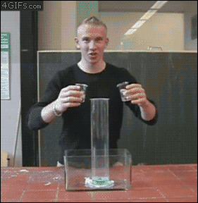
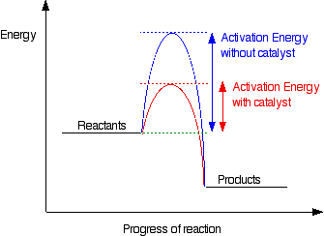
Catalysts!
2H₂O₂ → 2H₂O + O₂
KI
Catalysts work by lowering the amount of energy needed to reach the transition state of a chemical reaction.

Slide 15
Calculating ΔH_{rxn}: Two Ways
Using a Potential Energy Diagram
Calculate Using ΔH_{formations}
ΔH_{rxn}= ΣΔH_{f(products)} — ΔH_{f(reactants)}
ΔH_{rxn}
You will ALWAYS have access to these values.
ΔH_{rxn} = 350 kJ – 200 kJ = 150 kJ

Slide 16
ΔH_{f} Table (You will ALWAYS have this)
Chemical | ΔH_{f} (kJ/mol) | Chemical | ΔH_{f} (kJ/mol)
NH₃ | - 46 | HCl | - 92
CH₄ | - 75 | NH₄Cl | - 314
HCN | +135.1 | C₂H₅OH | - 278
H₂O (g) | - 242 | CO₂ | - 393.5
H₂O (l) | - 286 | MgO | - 602
Ca₃(PO₄)₂ | - 4126 | Mg(OH)₂ | - 925
H₂SO₄ | - 814 | Na₂O | - 416
CaSO₄ | - 1433 | CO | - 110.5
H₃PO₄ | - 1267
Elemental solids and diatomic molecules will always have a
ΔH_{f} value of 0 kJ!

Slide 17
Calculating ΔH_{rxn}
ΔH_{rxn}= ΣΔH_{f(products)} — ΣΔH_{f(reactants)}
Example: Calculate the ΔH_{rxn} for the following reaction:
2NH₃ (g) + 3O₂ (g) + 2CH₄ (g) → 2HCN (g) + 6H₂O (g)
Write an equation for this reaction
ΔH_{rxn}= Σ[2HCN + 6H₂O] – Σ[2NH₃ + 3O₂ + 2 CH₄]
Look up ΔH_{f} values on the table for EACH SUBSTANCE. Plug them in.
ΔH_{rxn}= Σ[2(135.1 kJ) + 6(-242kJ)] — Σ[2(-46kJ) + 3(0kJ) + 2(-75kJ)]
MATH. Plug in EXACTLY what you have written down. Make sure to include all of the parenthesis.
ΔH_{rxn}= -939.8 kJ/mol

Slide 18
Calculating ΔH_{rxn}
ΔH_{rxn}= ΣΔH_{f(products)} — ΣΔH_{f(reactants)}
Example: Calculate the ΔH_{rxn} for the following reaction:
2Na (s) + CO₂ (g) → Na₂O (s) + CO (g)
Write an equation for this reaction
ΔH_{rxn}= Σ[Na₂O + CO] – Σ[2Na + CO₂]
Look up ΔH_{f} values on the table for EACH SUBSTANCE. Plug them in.
ΔH_{rxn}= Σ[-416 kJ + -110.5 kJ] — Σ[2(0 kJ) + -393 kJ]
MATH. Plug in EXACTLY what you have written down. Make sure to include all of the parenthesis.
ΔH_{rxn}= -133.5 kJ/mol

