Slide 1
Isotopes

Slide 2
What is an isotope?
Not every atom is exactly the same
We know that different elements have different number of protons.
However even atoms of the same element are not exactly the same.
Atoms of the same element can have different number of neutrons. These are called Isotopes.

Slide 3
It’s all about the Mass Number
Because Isotopes differ in their number of neutrons, the mass of the atom also changes.
Isotopes are identified by their mass numbers.
Remember, mass number is the sum of what two particles?
Protons and Neutrons!

Slide 4
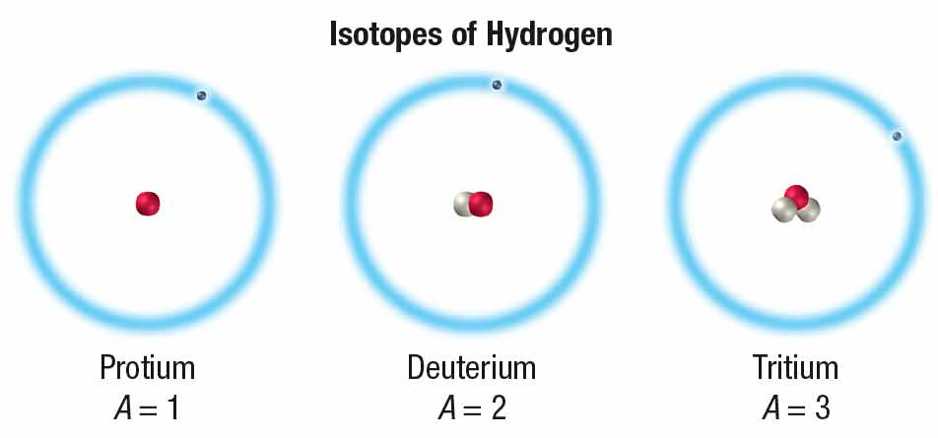
1 Proton 1 Proton 1 Proton
0 Neutrons 1 Neutron 2 Neutrons
Mass # = 1 Mass # = 2 Mass # = 3

Slide 5
Isotopic Notation
Isotopic Notation is generally how isotopes are written.
Mass number on top
Atomic number on bottom
This format makes it easy to calculate number of Neutrons
How do we calculate neutrons?

Slide 6
Isotopes have different mass numbers and also different numbers of neutrons.
Mass Number – Atomic Number = Neutrons

Slide 7
Identify the number of Protons, Neutrons, and Electrons for each of the following:
A) Carbon-12
B) Carbon-14
C) ¹⁰₄Be
D) Phosphorus-32

