Slide 1
Gas Notes Day 2: The Ideal Gas Law

Slide 2
What did you see in the PHeT?
Let’s watch and see if we can’t make some decisions on these relationships!
Relationship between volume and moles?
Direct or Inverse
Relationship between pressure and temperature?
Direct or Inverse
Relationship between pressure and volume?
Direct or Inverse
Relationship between temperature and volume?
Direct or Inverse

Slide 3
The Ideal Gas Law
What does it mean for a gas to be “ideal”?
Well, it means that it obeys the concepts behind this equation!
PV = nRT
Pressure must be in atm
Volume must be in L
Amount must be in moles
Temperature must be in Kelvin

Slide 4
How are these variables related?
Well, with a constant of course!
R = 0.08206 $\frac{L ∙ atm}{mol ∙ K}$
“R” is a constant that has been derived to help scientists calculate the values of variables when a gas behaves ideally.

Slide 5
Practice Calculations using PV=nRT
1. How many moles of oxygen will occupy a volume of 2.5 liters at 1.2 atm and 25ºC?
Step 1: Identify your given information and see what you have to find.
Step 2: Do you have to do any conversions before you use PV = nRT?
Given Information:
P = 1.2 atm
V = 2.5 L
T = 25ºC
Find:
Moles (n)
Yes! Temperature must be in Kelvin.
T = 25 + 273.15
T = 298. 15 K

Slide 6
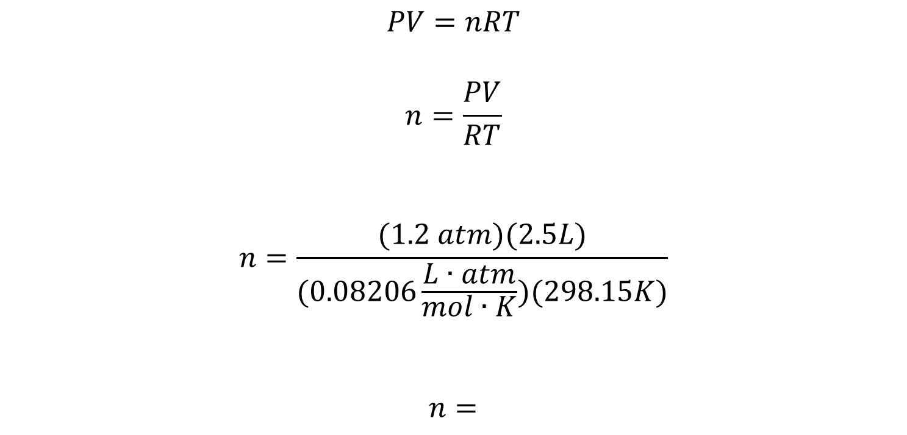
Practice Calculations using PV=nRT
1. How many moles of oxygen will occupy a volume of 2.5 liters at 1.2 atm and 25ºC?
Step 3: Rearrange and plug it in!
$$PV=nRT$$
$$n=\frac{PV}{RT}$$
$$n=\frac{(1.2 atm)(2.5L)}{(0.08206\frac{L∙atm}{mol∙K})(298.15K)}$$
$n=$

Slide 7
Your Turn: Practice using PV=nRT
Please do AT LEAST five more problems from the Gases WS #2!
Remember the steps:
Step 1: Identify your given information and see what you have to find.
Step 2: Do you have to do any conversions before you use PV = nRT?
Step 3: Rearrange the equation and plug in the information!

