Slide 1
Chemistry
Bond Polarity and Molecular Geometry

Slide 2
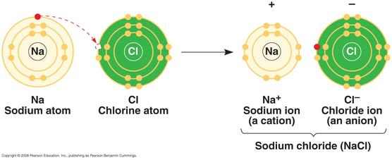
Just a Quick Review
Ionic Bonds
Covalent Bonds
Transfer of electrons.
Occurs between a metal and a nonmetal.
The result is two ions, attracted to each other.
Sharing of electrons.
Occurs between two nonmetals.
The result is two atoms, sharing valence electrons.
••
••
H
Cl
H
Cl
+
•
•
•
•
••
••
Overlap of H (1s) and Cl (2p)

Slide 3
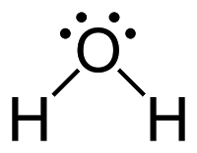

Just a Quick Review
Ionic Bonds
Covalent Bonds
In the Lewis Dot Structures……
In the Lewis Dot Structures……

Slide 4
Covalent Bonds
A covalent bond results from an overlap of atomic orbitals on neighboring atoms.
••
••
H
+
Cl
•
H
Cl
•
•
•
••
••
Overlap of H (1s) and Cl (2p)
Note that each atom has a single, unpaired electron.

Slide 5
Bond Pairs and Lone Pairs
Valence electrons are distributed as shared or BOND PAIRS and unshared or LONE PAIRS.
••
H
Cl
•
•
••
lone pair (LP)
shared or
bond pair

Slide 6
Drawing Covalent Lewis Dot Structures
Decide on the central atom (never Hydrogen). If there is a choice, the central atom is the least electronegative.
Draw the Lewis Dot Structures for the individual atoms, making sure to put the central atom in the middle of the structure.
Form single bonds between the central atom and the surrounding atoms. Each bond takes two electrons.
Check to make sure that each atom has a full octet (or duet in the case of Hydrogen).
**If atoms do not have a full octet, make double or triple bonds.

Slide 7
Now You Try One!
Draw Carbon tetrachloride, CCl₄

Slide 8
Now You Try One!
Draw Sulfur Dioxide, SO₂

Slide 9
Violations of the Octet Rule
Usually occurs with B and elements of higher periods. Common exceptions are: Be, B, P, S, and Xe.
Be: 4
B: 6
P: 8 OR 10
S: 8, 10, OR 12
Xe: 8, 10, OR 12
SF₄
BF₃

Slide 10
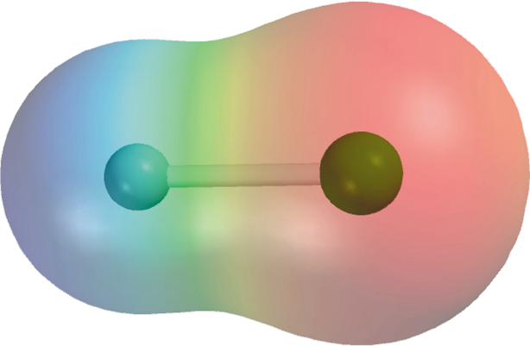
Bond Polarity
What if there a significant difference in electronegativity, but not enough to create an ionic bond?
H
F

Slide 11
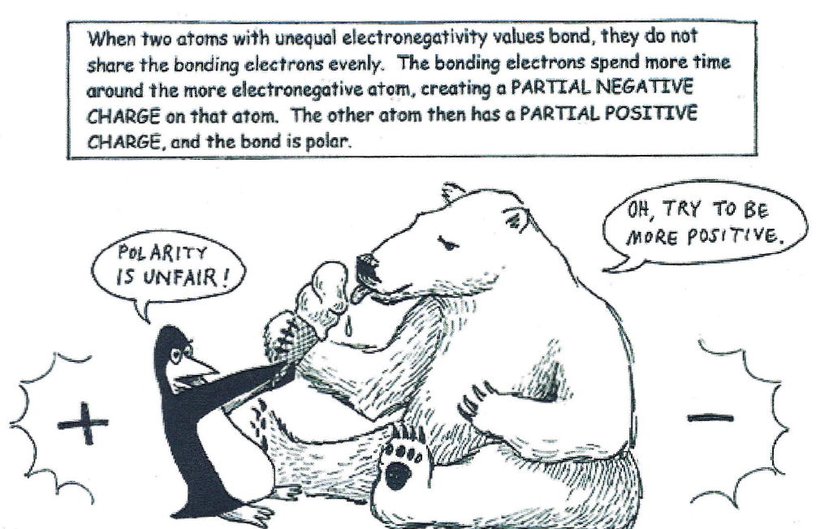
Share out what we learned from HW

Slide 12
Polarity….exists in two forms
Bond Polarity
We are looking at the difference in electronegativies between atoms to determine how they share their electrons.
Evenly or Unevenly
Molecule Polarity
We are looking at all the atoms surrounding the center atom and determine if there is symmetry or not.
Symmetrical or Asymmetrical

Slide 13
Bond Polarity
The difference in electronegativities affects how atoms bond together.
Using the electronegativity values, we can predict the type of bond that forms.
Although all covalent bonds involve the sharing of electrons, most of the time this sharing is not equal.

Slide 14
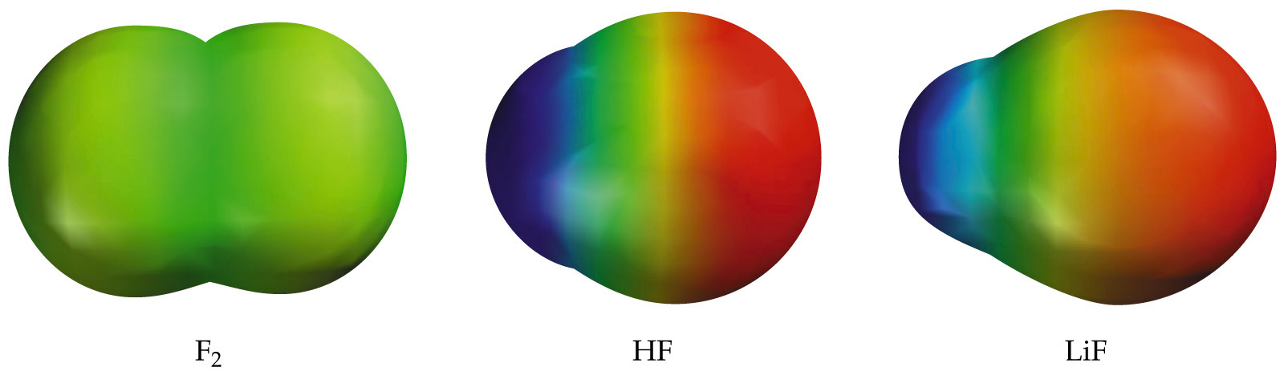
If one atom has a higher electronegativity than the other atom, it “hogs” the shared bonded pair of electrons most of the time.
This type of covalent bond is known as a polar covalent bond.
Polar bonds mean NOT EVENLY SHARED!
SF

Slide 15
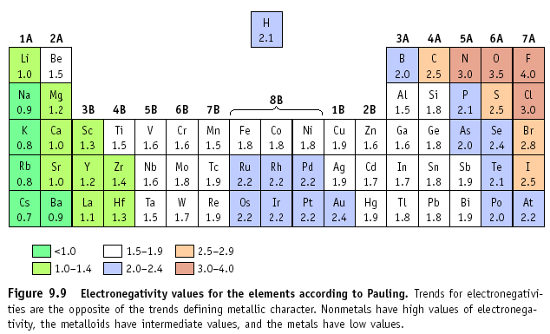
Electronegativity Difference
If the difference in electronegativity is between:
  1.7 to 4.0: Ionic
    A big difference, so an element pulls an electron off another.
  0.5 to 1.6: Polar Covalent
    A moderate difference, so they have to share, but not evenly.
  0.0 to 0.4: Non-Polar Covalent
    A small difference, so they share, and share evenly.
  Example: NaCl
  Na = 0.8, Cl = 3.0
  Difference is 2.2, so
  this is an ionic bond!

Slide 16
Bond Polarity
HCl is POLAR because it has a positive end and a negative end. (difference in electronegativity)
Cl has a greater share in bonding electrons than does H. We draw a dipole moment showing how the shared electrons are being pulled.
Cl has slight negative charge ( - δ)
H has slight positive charge (+ δ)

Slide 17
Polarity of Whole Molecule
Determining the polarity of a bond is easy, but what about the molecule as a whole?
Strangely enough, you can have nonpolar molecules that contain polar bonds!
SO….
How do you determine if a molecule itself is going to be polar or nonpolar?
Look at the Lewis Structure and check out the central atom!

Slide 18
Determining if a Molecule is Nonpolar or Polar
Look at what is attached to the central atom
If every attached structure is the same
If the attached structures are different
The molecule is perfectly symmetrical
The molecule is asymmetrical
And therefore NONPOLAR
And therefore POLAR

Slide 19

Polar Bond
δ⁺
δ ⁻
Asymetrical
Polar Molecule

Slide 20
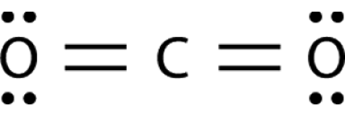
Polar Bonds
δ ⁻
δ ⁺
δ ⁺
δ ⁻
However, the shape is symmetrical
So…
The molecule is nonpolar

Slide 21
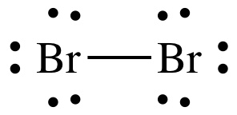
Nonpolar Bond
Symmetrical
Nonpolar Molecule

