Slide 1
THE SYLLABUS Rules Procedures

Slide 2
Learning Targets:
I CAN describe how to behave safely in lab.
I CAN select the correct measurement tool
in a lab setting.
I CAN record laboratory measurements
using the correct number of significant
digits, utilizing accuracy and precision.

Slide 3
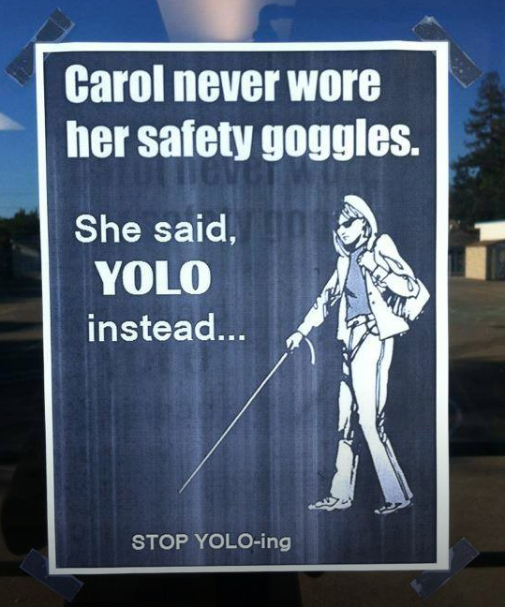
Safety is our top priority!

Slide 4
Safety Contract
We will take a safety and syllabus quiz on THURSDAY

Slide 5
What is safety?
The best safety video EVER:
http://www.youtube.com/watch?v=VRWRmIEHr3A
Another AMAZING music video for you:
http://www.youtube.com/watch?v=xJG0ir9nDtc

Slide 6
Questions?
Talk to your neighbor, is there anything you are confused on or need clarification on with Safety rules?
Remember, you are responsible for all of the safety rules while in lab and will be quizzed on this material on Friday!

Slide 7
Chem Notes
Format is your choice. Suggestions:
Do NOT write down everything that is on the board. Include important definitions and practice problems.
Two column notes (Important Ideas on left, details and examples on right)
Listen and complete practice problems, then review at home tonight (the last step is important!)

Slide 8
Chem Notes No-No’s:
The Cell Phone Rule:
All cell phones may be out, but must be SCREEN DOWN.
You may listen to music during individual or group work. No Instagram, snapchat, or pokémon go. If I can’t catch ‘em all, the neither can you.
Starting homework
The chances that you practice incorrectly are too high, and practice makes permanent!
Having anything other than your composition notebook/unit packet out.
Completing work for other classes.
That’s just rude!

Slide 9
Unit 1: Measurements in Science
Measurement is one of the most basic foundations of good laboratory technique.
Today, we will be practicing measuring objects and solutions using those techniques in the measurement lab.
But first…. What is good technique?
Accuracy
Precision
Talk with your neighbor: what do these two words mean?

Slide 10
What is the difference between accuracy and precision?
Can something be both precise and accurate?
Can something be neither accurate nor precise?

Slide 11
Precision
A measurement or calculation as represented by the consistency of results.
How close together your results are to one another regardless of the actual answer.

Slide 12
Accuracy
The degree to which the result of a measurement or calculation conforms to the correct value or a standard.
How close you are to the actual answer.

Slide 13
Taking Measurements
When taking measurements, you always measure one digit past what you can see.
This is called the “limit of precision.”

Slide 14
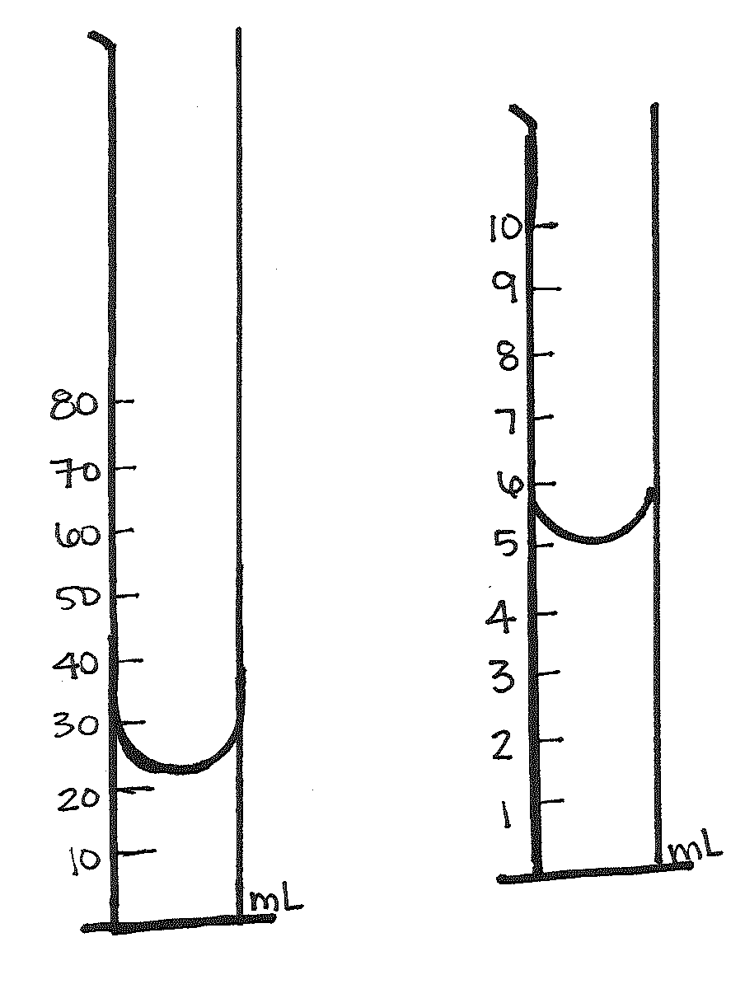
Examples:
How would you read the two graduated cylinders to the right?

Slide 15
REMEMBER UNITS!!!
All numbers must be followed by a unit
Liters = L
Milliliters = mL
Grams = g
Naked numbers have no meaning in science! Thus will receive no credit!

Slide 16
Measurement Lab
Purpose: Practice taking measurements and appropriately calculating results.
Nuts and Bolts:
Take your time – rushing will not help you
Work with a partner or alone
Yes, you need to wear goggles
Done? Answer the summary questions on the last page and prepare for your safety quiz!

Slide 17
Science Homework
Today’s Date:
Wednesday, 8-19-2015
Homework:
Study for your safety quiz!
Bring class materials….and a calculator!
Note:
Bring materials Friday to set up science binder

