Slide 1
Conversions
Using Molar Mass to Count!

Slide 2
Scientific Notation Review
To write numbers in scientific notation, move the decimal so that it:
Has one non-zero number to the left of the decimal place
Is multiplied by 10^{x}
The exponent is positive if the number in standard notation is larger than 1
The exponent is negative if the number in standard notation is less than 1
Examples:
Standard notation = 12000. (This # is larger than 1) Scientific notation = 1.2000 x 10⁴
Standard notation = 0.001200 (This # is smaller than 1) Scientific notation = 1.200 x 10⁻³

Slide 3
Scientific Notation Practice
Convert these numbers into either scientific or standard notation.
0.00153
1,200.
1,350
0.01800

Slide 4
Significant Figures Review
How many sig figs are in the following numbers?
302 mL
548.8 g
240 cm
24.0 L
0.180 g
58700 mL

Slide 5
Conversion Factors Review
Conversion Factor: Fractions in which the numerator and denominator are EQUAL quantities expressed in different units.
Equality: 1 in. = 2.54 cm
Conversion Factors: 1 in. Or 2.54 cm
2.54 cm 1 in.
With your neighbor: discuss two ways you could describe these fractions.

Slide 6
Why use a conversion factor?
Your units are clearly indicated.
Reduces confusion on whether to multiply or divide.
Prepares you to complete more complex problems.

Slide 7
Question: How many minutes are in 2.5 hours?
What do you know about the problem?
2.5 hours
1 hour = 60 minutes
60 minutes
2.5 hours
=
150 minutes
1 hour
Sig Figs:
Conversion factors are exact numbers
Units must cancel!

Slide 8
Question #2: You have $7.25 in your pocket in quarters. How many quarters do you have?
Identify what you know
You have $7.25
$1 = 4 quarters
4 quarters
$7.25
=
29.0 quarters
$1
Sig Figs:
Conversion factors are exact numbers
Units must cancel!

Slide 9
The Metric System
Metric Base Units [B]
Liters (measuring volume)
Meters (measuring length)
Grams (measuring mass)
Multiples of 10
Examples:
1 kilogram = 1000 grams
1 gram = 100 centigrams
1 gram = 1000 milligrams

Slide 10
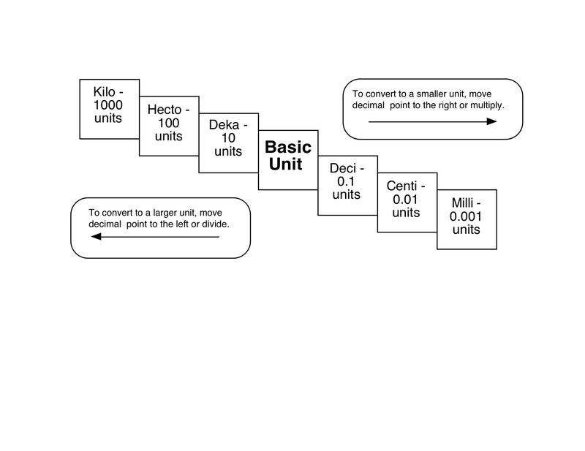
The units to the RIGHT are SMALLER than the base unit!
The units to the LEFT are LARGER than the base unit!

Slide 11
Question #3: How many centigrams are in 605 g?
What do you know?
605 grams
1 gram = 100 centigrams
605 grams
100 centigrams
=
60,500 centigrams
1 gram
Sig Figs:
Conversion factors are exact numbers
Units must cancel!

Slide 12
Question #4: How many meters are in 14 km?
What do you know?
14 kilometers
1000 meters = 1 km
1000 m
14 km
=
1.4 x 10³ m
OR
14,000 m
1 km
Units must cancel!
Sig Figs:
Conversion factors are exact numbers

Slide 13
Learning How to Count in Chemistry
You are going to help me figure out to how count beans!
What you need:
Calculator
Pencil
Notes sheet of your packet.

Slide 14
Learning How to Count in Chemistry
STEPS 1-3:
Mass of 25 beans (trial 1):
Mass of 25 beans (trial 2):
Average mass of 25 beans:
STEPS 4-6
Grab a “bunch” of beans….
How can we determine how many are in a bunch…. WITHOUT COUNTING?

Slide 15
The Mole is a Way of Counting!
1 dozen =
12
1 gross =
144
1 ream =
500
1 mole =
6.02 x 10²³
That is a REALLY BIG number…

Slide 16
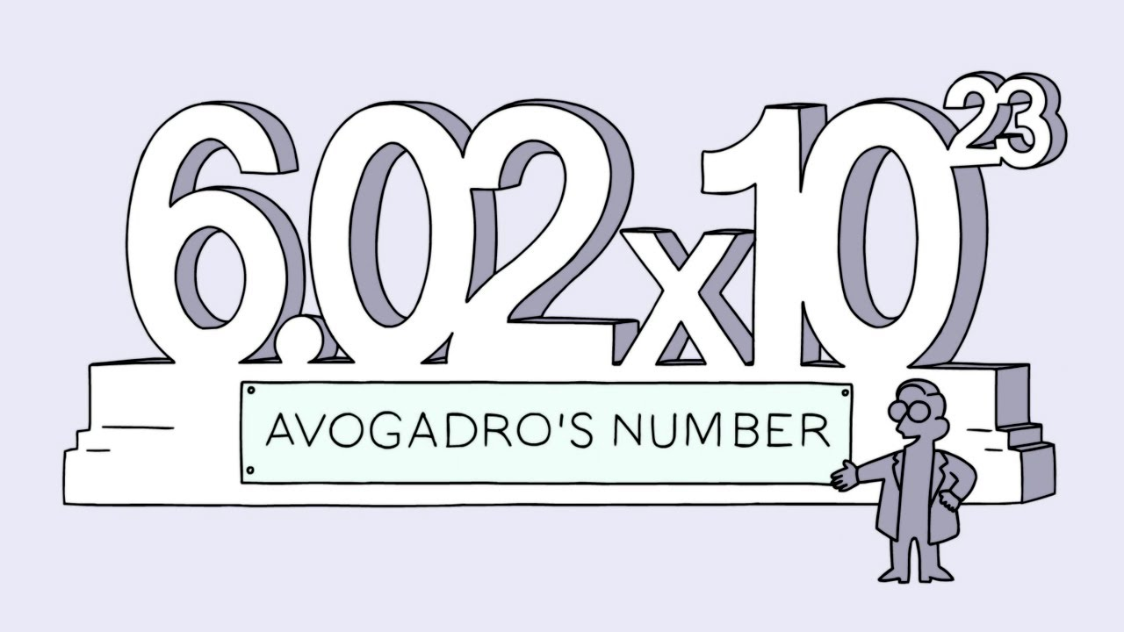
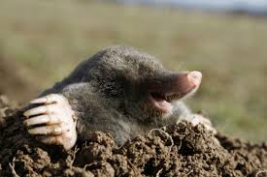
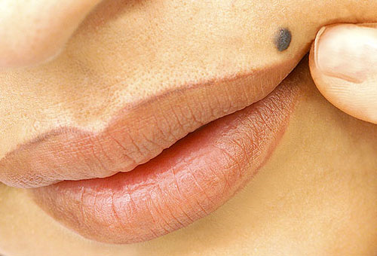
Chemists Count Using…… The MOLE!

Slide 17
HONORS ONLY: Practicing with Conversions-- M&M Lab
If we were to cover the entire state of South Carolina with 6.02 x 10²³ (1 mole) of M&Ms, how high would the M&Ms be stacked?

Slide 18
Mole Video http://www.youtube.com/watch?v=TEl4jeETVmg
In your Notes Section:
While watching write or draw either:
A new fact you learned
or
A connection you made
or
A question you still have

Slide 19
The Mole
1 dozen cookies = 12 cookies
1 mole of cookies = 6.02 X 10²³ cookies
1 dozen cars = 12 cars
1 mole of cars = 6.02 X 10²³ cars
1 dozen Al atoms = 12 Al atoms
1 mole of Al atoms = 6.02 X 10²³ Al atoms
Note that the NUMBER is always the same, but the MASS is very different!
*Mole is abbreviated mol

Slide 20
Practice! Moles Inquiry Activity (Pages 1-3)

Slide 21
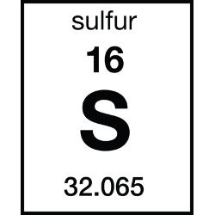
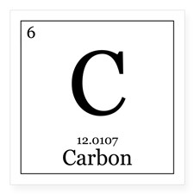
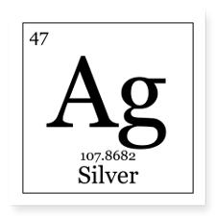
Molar Mass
Molar Mass: The mass of one mole of an element.

Slide 22
Molar Mass
What is the molar mass of the following:
Mg
H
N
How about these?
N₂
SO₄
Cu(NO)₃

Slide 23
One More!
How about… Copper (II) Chloride?

Slide 24
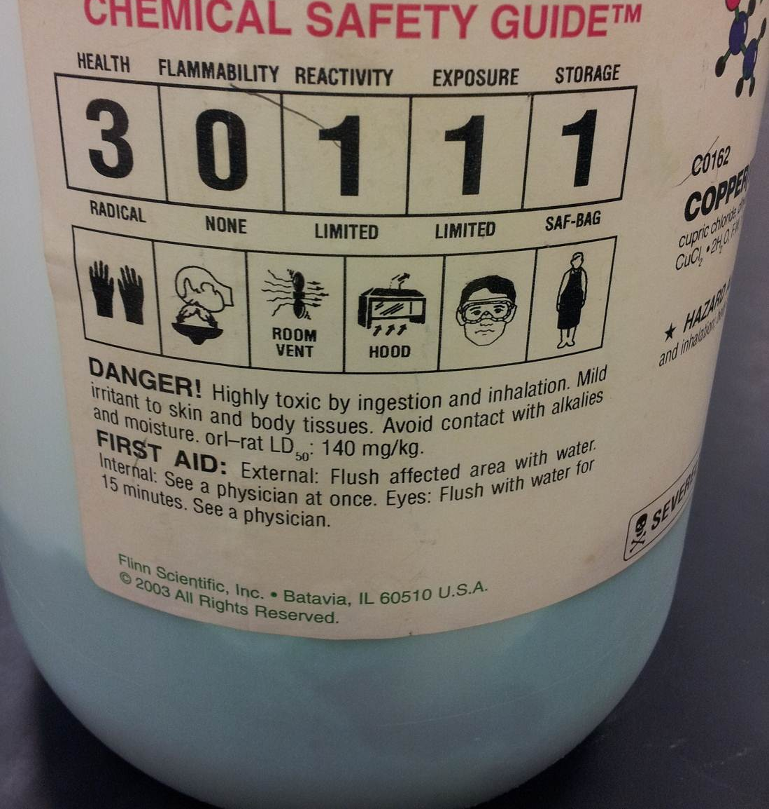
What is Copper (II) Chloride?

Slide 25
What is the Molar Mass of Copper (II) Chloride?

Slide 26
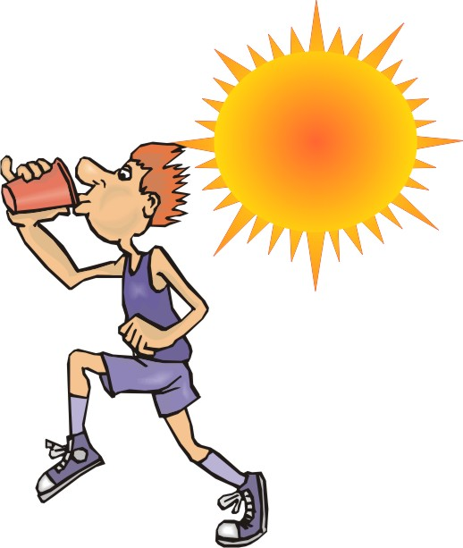
Hydrate:
Water is added in the natural state.
Draw Copper (II) Chloride Dihydrate

Slide 27
How to Calculate the Molar Mass of a Hydrate
Name: Copper (II) Chloride Dihydrate
Write the Formula: CuCl₂ ● 2H₂O
Cu = 63.54 g/mole
2(Cl) = 2 x 35.45 g/mole
4(H) = 4 x 1.01 g/mole
2(O) = 2 x 16.00 g/mole
= 170.49 g/mole

Slide 29
Team Huddle!
Find a partner!
Grab a white board and a marker.
Answer the following questions
Remember to show ALL of your work.
You need units!
Sig Figs Count!

Slide 30
Team Huddle Question #1
What is the molar mass of CuSO₄?

Slide 31
Team Huddle Question #2
What is the mass of 0.5 moles of H₂?

Slide 32
Team Huddle Question #3
How many moles are in 12.5 grams of Magnesium Hydroxide?

Slide 33
Team Huddle Question #4
How many grams are in 4.3 moles of Aluminum Chloride?

Slide 34
Team Huddle Question #5
How many atoms are in 1.46 moles of H₂?

Slide 35
Team Huddle Question #6
How many molecules are in 0.45 moles of lithium bromide?

Slide 36
Team Huddle Question #7
How many molecules are in 96 grams of carbon dioxide?

Slide 37
Team Huddle Question #8
How many grams would 1.0 x 10 ²⁵ molecules of copper (II) chloride weigh?

