Slide 1
Chemical (Intramolecular) Bonding

Slide 2
Review of the Periodic Table

Slide 3
Review of Valence Electrons

Slide 4
Types of Chemical Bonds
There are 3 forms of chemical bonding:
IONIC: Occurs between a metal and a nonmetal Complete transfer of 1 or more valence electrons from one atom to another (One loses electrons that the other gains, forming oppositely charged ions that attract one another)
COVALENT: Occurs between two nonmetals Some valence electrons are shared between atoms
METALLIC: Occurs between two metals A sea of electrons that can hold metals together
*Most bonds are somewhere between ionic and covalent

Slide 5
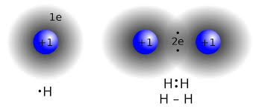
Covalent Bonds
Covalent bonds are formed by sharing electrons. Two atoms with strong electronegativity attract the same electron to their nucleus.

Slide 6
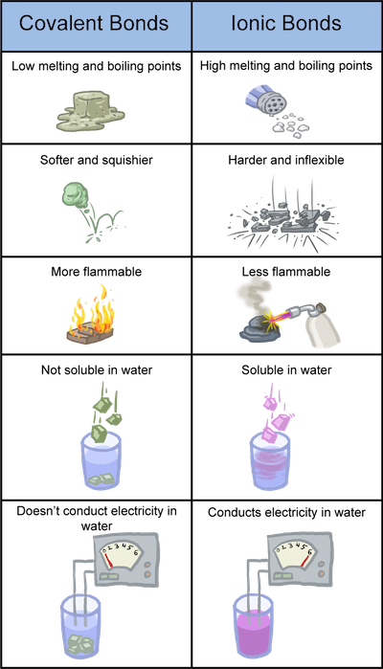
Properties of Covalent Molecules
Low melting and boiling points
Most are liquids or gases at room temperature
Do not conduct electricity when molten or dissolved in water
Generally, weaker bonds than ionic compounds

Slide 7
Lewis Dot Structures: Covalent Bonds
Covalent Bonds: sharing of some valence e⁻ between nonmetals until all atoms obey the Octet Rule (have 8 valence e⁻)
Nonpolar Covalent – Atoms share electrons equally (no charges)

Slide 8
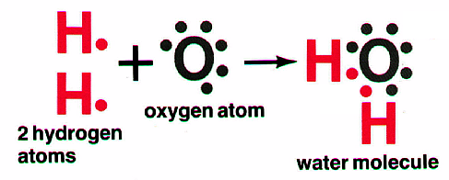
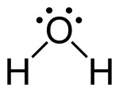
Lewis Dot Structures: Covalent Bonds
Covalent Bonds: sharing of some valence e⁻ between nonmetals until all atoms obey the Octet Rule (have 8 valence e⁻)
Polar Covalent – Atoms share electrons unequally (partial charges)
δ⁺
δ⁻
δ⁺

Slide 9
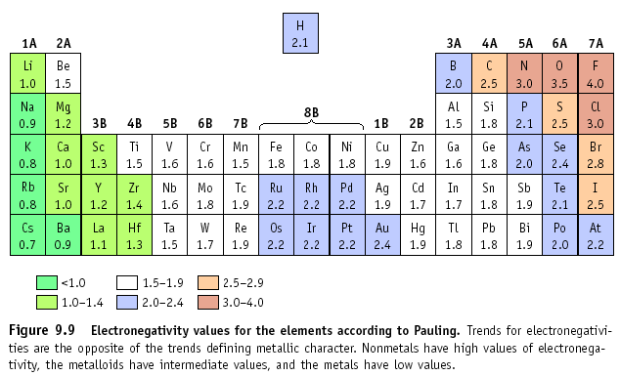
The type of bond can also be determined by examining the difference in electronegativity between the atoms.

Slide 10
Determining Types of Bonds
If the difference in electronegativity is between:
1.7 to 4.0: Ionic
0.3 to 1.7: Polar Covalent
0.0 to 0.3: Non-Polar Covalent
Example: H₂O
H = 2.1, O = 3.5
Difference is 1.4, so
this is a polar covalent bond!

Slide 11
Question Time!
Draw the covalent bonding for the following:
PCl₃ SiCl₂ H₂
Cl₂ SiS₂ PH₃
SCl₂ Al₂O₃ NCl₃

