Slide 1
Gas Notes: Kinetic Molecular Theory

Slide 2
Kinetic Molecular Theory
The theory that explains why gases behave the way they do and can help you to predict how a gas will behave.
There are five principles of KMT.

Slide 3
Kinetic Molecular Theory
1. Gases consist of tiny particles (atoms or molecules)
2. These particles are so small, compared with the distances between them, that the size of the individual particles can be assumed to be negligible (zero).
Gases are COMPRESSIBLE

Slide 4
Kinetic Molecular Theory
3. The particles are in constant random motion, colliding with the walls of the container.
Gases exert Pressure.

Slide 5
Pressure
What is pressure?
Pressure is the force extered by a gas particle on the container, or on another gas particle.

Slide 6
Pressure
How is it measured?
mmHg (or Torr)
Atmospheres (atm)
Pascals (used in physics: 1 pascal = 1 newton per square meter)
Pounds Per Square Inch (psi)
Equivalences (WRITE THESE DOWN):
1 atm = 760 mmHg
1 atm = 101,325 Pa = 101.325 kPa
1 atm = 14.7 psi

Slide 7
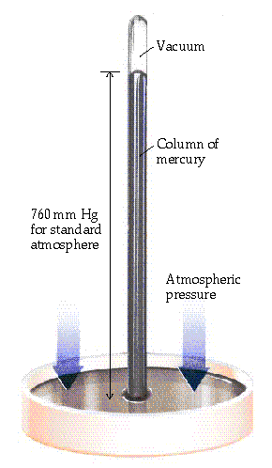
Pressure
Atmospheric pressure is measured with a barometer.

Slide 8
Pressure Calculations
What is 475 mm Hg expressed in atm?
475 mm Hg
1 atm
=
0.625 atm
760 mm Hg

Slide 9
Pressure Multiple Gases
Dalton’s Law of Partial Pressures
The total pressure of gas is equal to the sum of the individual pressures.
P_{total} = P_{gas A} + P_{gas B +} P_{gas C} + P_{gas D}

Slide 10
Pressure Calculations
What is the total pressure (in atm) of a container that contains Helium gas at 750 torr, Oxygen gas at 120 mmHg, and Nitrogen gas at 3.2 atm?
P_{total} = P_{Helium}+ P_{Oxygen +} P_{Nitrogen}
$$P_{total}=\left(750 torr×\frac{1 atm}{760 torr}\right)+\left(120 mmHg×\frac{1 atm}{760 mmHg}\right)+3.2 atm$$
$$P_{total}=0.99 atm+0.16 atm+3.2 atm$$
P_{total} = 4.4 atm

Slide 11
Kinetic Molecular Theory
1. Gases consist of tiny particles (atoms or molecules)
2. These particles are so small, compared with the distances between them, that the size of the individual particles can be assumed to be negligible (zero).
Gases are COMPRESSIBLE
3. The particles are in constant random motion, colliding with the walls of the container.
Gases exert Pressure.

Slide 12
Kinetic Molecular Theory
4. The particles are assumed not to attract or to repel each other.
Intermolecular Forces
5. The average kinetic energy of the gas particles is directly proportional to the Kelvin temperature of the gas.

Slide 13
Temperature
What is temperature? Hint: Think back to Thermodynamics
How is it measured?
Temperature is a measure of the average kinetic energy of molecule.

Slide 14
Temperature Scales
Celsius
Kelvin
Fahrenheit
Boiling point of water
100 ˚C
373.15 K
212 ˚F
100˚C
100 K
180 ˚F
Freezing point of water
0 ˚C
273.15 K
32 ˚F
Notice that 1 Kelvin = 1 degree Celsius

Slide 15



Temperature Conversions
Equation: T(°F) = $\frac{9}{5}$ T(°C) + 32
Example: A person with hypothermia has a body temperature of 29.1 °C. What is the body temperature in °F?
°F = $\frac{9}{5}$ (°C) + 32
°F = $\frac{9}{5}$ (°29.1) + 32
°F = 52.4 + 32
$$84.4\text{°}\text{F}$$

Slide 16
Temperature Conversions
All calculations for gases require temperature in Kelvins.
Equation: T (K) = T(˚C) + 273.15
Example: A person with hypothermia has a body temperature of 29.1 °C. What is the body temperature in K?
T (K) = T(˚C) + 273.15
T(K) = 29.1 ˚C + 273.15
302.3 K

Slide 17
Kinetic Molecular Theory
1. Gases consist of tiny particles (atoms or molecules)
2. These particles are so small, compared with the distances between them, that the size of the individual particles can be assumed to be negligible (zero).
Gases are COMPRESSIBLE
3. The particles are in constant random motion, colliding with the walls of the container.
Gases exert Pressure.
4. The particles are assumed not to attract or to repel each other.
Intermolecular Forces
5. The average kinetic energy of the gas particles is directly proportional to the Kelvin temperature of the gas.

