Slide 1
THERMOCHEMISTRY
States of Matter
Heating and Cooling Curves
Phase Diagrams

Slide 2
Thermochemistry
Most simply, it means “chemistry of heat” but we broaden it to mean energy in general
Every physical and chemical change involves some sort of change in energy.
Every time a bond is made or broken, energy is required.
Breaking bonds requires energy
Forming bonds releases energy

Slide 3
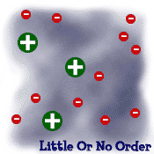
STATES OF MATTER:
SOLID
LIQUID
GAS
PLASMA
Tightly packed, in a regular pattern
Vibrate, but do not move from place to place
Close together with no regular arrangement.
Vibrate, move about, and slide past each other
Well separated with no regular arrangement.
Vibrate and move freely at high speeds
Has no definite volume or shape and is composed of electrical charged particles

Slide 4
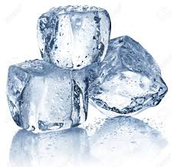
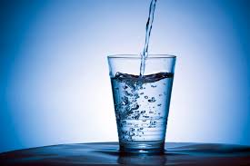
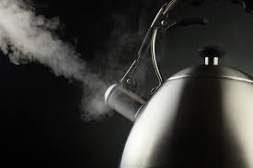
PHASE CHANGES
Sublimation
Melt
Vaporize
Freeze
Condense
Deposition

Slide 5
Heating Curves Lab
If we had to graph this... what would it look like?

Slide 6
PHASE CHANGES
Sublimation
Melt
Vaporize
Freeze
Condense
Deposition
Endothermic: Requires energy
Exothermic: Releases energy

Slide 7
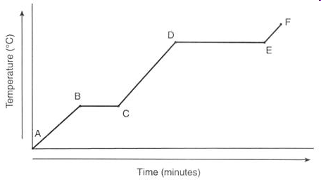
Heating Curve for Water
Gas
Liquid
Solid
This is what the graph would look like if I took some ice cubes, put them in a beaker, and heated them with a bunsen burner.

Slide 8
Heating Curve for Water
What changes do the horizontal lines indicate?
What changes do the sloped lines indicate?

Slide 9
Heating Curve for Water
What is happening between point B and C?
What is happening between point D and E?
Is energy being absorbed or released as the graph proceeds to the right?

Slide 10
Learning Check
A. Water condenses at a temperature of
1) 0°C 2) 50°C 3) 100°C
B. When a gas condenses, energy is ___________.
1) released 2) absorbed
C. The process of melting is____________.
1) endothermic 2) exothermic

Slide 11
Learning Check
Is energy absorbed (1) or released (2) in each of the following:
____A. Ice to liquid water
____B. Water vapor to rain
____C. Water to ice
Something to think about: Why do drops of liquid water form on a glass of iced tea ?

Slide 12
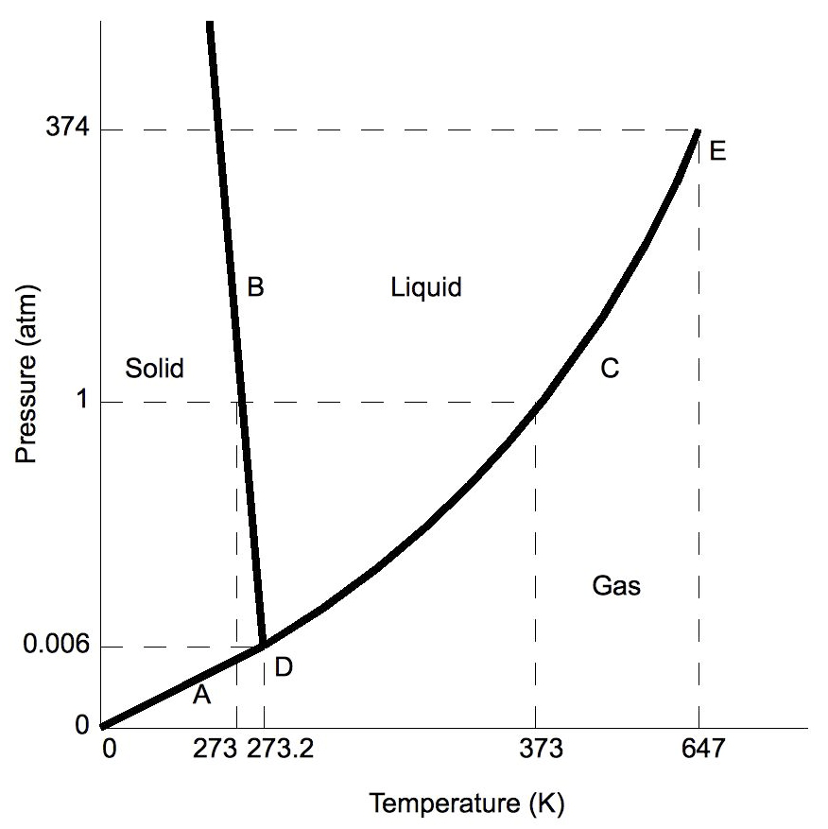
Honors: Phase Diagrams
This is the phase diagram for water. ---------------------------->
At standard pressure, what temperature does water melt and boil?
The temperature at which a phase change happens can change depending on the pressure.
A phase diagram shows the temperatures and pressures necessary for each state of matter to exist.
This is why there are different cooking directions for “high altitudes.”

Slide 13
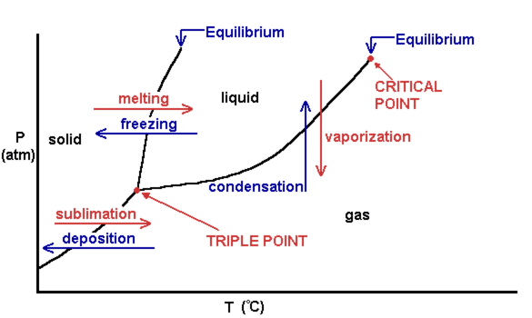
Each black line represents the conditions when a phase change occurs.
Honors ONLY

Slide 14
Triple Point – point that exist when all three states of matter are present at the same time
Critical Point – point on a phase diagram where the liquid phase has the same density as the gas phase and are indistinguishable.
No matter what pressure is applied, it cannot condense into a liquid.
Honors ONLY

Slide 15
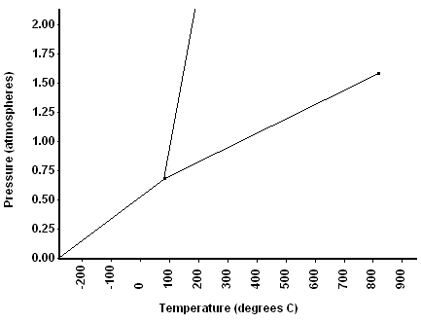
Learning Check
1) What phase would it be at a pressure of 0.75 and a temp of 0?
2) What phase would it be at 0.75 atm and temp of 200?
Honors ONLY

