Slide 1
Chemical (Intramolecular) Bonding

Slide 2
Review of the Periodic Table

Slide 3
Review of Valence Electrons

Slide 4
Question Time!
How many valence electrons result in a stable atom?
How many valence electrons does ___ have?
Ca Ca⁺¹ S S⁻² Ne He

Slide 5
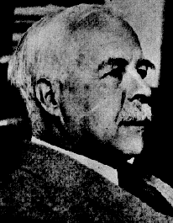
Electron Distribution in Atoms
What are some ways we have looked at the location of electrons in an atom?
Lewis Dot Structures show only the number of valence electrons in an atom and can show how many bonds it can form.
G. N. Lewis
1875 - 1946

Slide 6
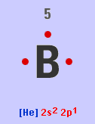
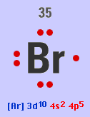
Lewis Dot Structure Examples:
Boron
Bromine

Slide 7
Question Time!
Draw the Lewis Dot Structures for the following atoms:
C H Al Cl Mg
Na O Ca Ne S

Slide 8
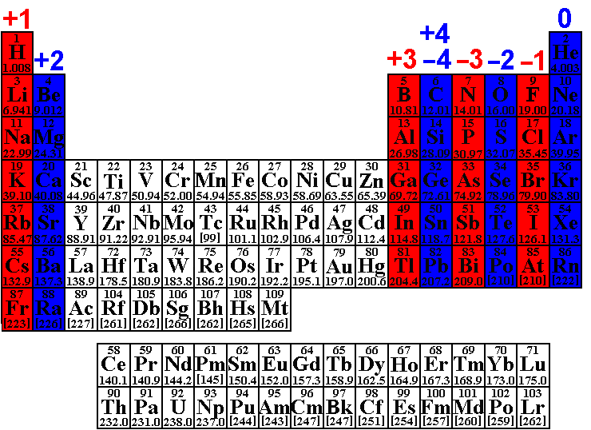
Common Ion Formation

Slide 9
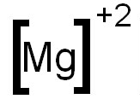
Lewis Dot Structures for Ions Examples:
Magnesium
Oxygen

Slide 10
Question Time!
Draw the Lewis Dot Structures for the following ions:
S⁻² Al⁺³ Cl⁻¹

Slide 11
But atoms usually never exist alone. What happens when two atoms join together?

Slide 13
Types of Chemical Bonds
There are 3 forms of chemical bonding:
IONIC: Occurs between a metal and a nonmetal Complete transfer of 1 or more valence electrons from one atom to another (One loses electrons that the other gains, forming oppositely charged ions that attract one another)
COVALENT: Occurs between two nonmetals Some valence electrons are shared between atoms
METALLIC: Occurs between two metals A sea of electrons that can hold metals together
*Most bonds are somewhere between ionic and covalent

Slide 14
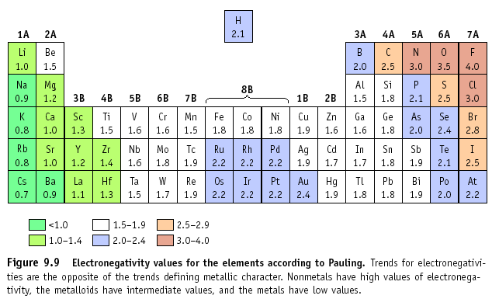
The type of bond can also be determined by examining the difference in electronegativity between the atoms… we’ll look at this later.

Slide 15
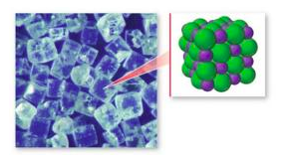
Ionic Bonds
All ionic compounds are made from ionic bonds. Positive cations and the negative anions are attracted to one another (Opposites Attract!)
When this happens, small crystal structures form (like SALT)!

Slide 17
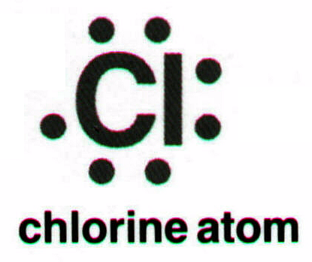
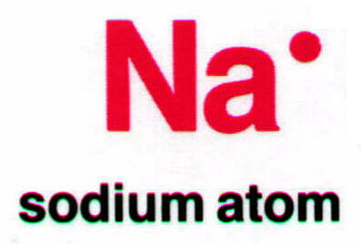
Lewis Dot Structures: Ionic Bonds
Ionic Bonds: a transfer of e⁻ from the metal (cation) to nonmetal (anion)

Slide 18
Question Time!
Draw the ionic bonding between the following elements:
Calcium and Phosphorous
Aluminum and Chlorine
Beryllium and Oxygen
Lithium and Sulfur
Potassium and Bromine

Slide 19
So…. what would you call these?

