Slide 1
Acids and Bases

Slide 2
What makes something an acid?
Usually sour tasting
Corrosive
Burn skin
Can be helpful

Slide 3
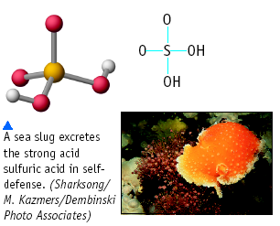
Example of Acid
Stomach Acid
Orange Juice
Lemonade
Vinegar

Slide 4
Definitions of an Acid
Arrhenius:
  An acid is any substance that ionizes to releases H⁺ ions into solution.
  HNO₃(aq) → H⁺ (aq) + NO₃⁻(aq)
Bronsted-Lowry:
  An acid is any substance that donates H⁺ ions to solution.
  H₂O(l) + HCl(aq) → H₃O⁺(aq) + Cl⁻(aq)

Slide 5
Acids in Reactions
Acids ionize and ‘donate’ a proton or H⁺ to a reaction
HCl + NaOH → NaCl + H(OH)
Monoprotic- an acid that can donate only 1 proton to a base (HCl)
Diprotic- an acid that has two ionizable hydrogen atoms in each molecule, such as sulfuric acid (H₂SO₄)
Triprotic-??????

Slide 6
Types of Acids
Strong Acids (100% ionize)
Weak Acids
HCl
HI
HBr
HNO₃
HClO₄
H₂SO₄
Everything else!

Slide 7
What makes something a base?
Taste bitter and feel slippery
Settle Upset Stomachs
Burn Skin
Detergents and many cleaning solutions

Slide 8
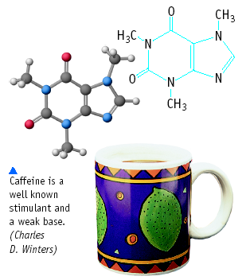
Examples of Bases
Bleach
Egg White
Detergent

Slide 9
Definitions of a Base
Arrhenius:
  A base is any substance that dissociates to releases OH⁻ ions into solution.
  LiOH (s) → Li⁺ (aq) + OH⁻(aq)
Bronsted-Lowry:
  A base is any substance that accepts H⁺ ions from solution.
  NH₃(aq) + H₂O (l) → NH₄⁺(aq) + OH⁻(aq)

Slide 10
Types of Bases
Strong Bases (100% dissociate)
Weak Bases
LiOH
NaOH
KOH
Ca(OH)₂
Sr(OH)₂
Ba(OH)₂
Everything else!

Slide 11
When acids and bases meet
Neutralization Reaction
3KOH + H₃PO₄ → K₃PO₄ + 3HOH
base
acid
salt
water

Slide 12
In the following problems, write out the balanced reaction and identify the acid, base and salt
1. Barium Hydroxide is mixed with Sulfuric Acid (H₂SO₄)
2. Water and potassium nitrate are the products of an acid-base reaction.

Slide 13
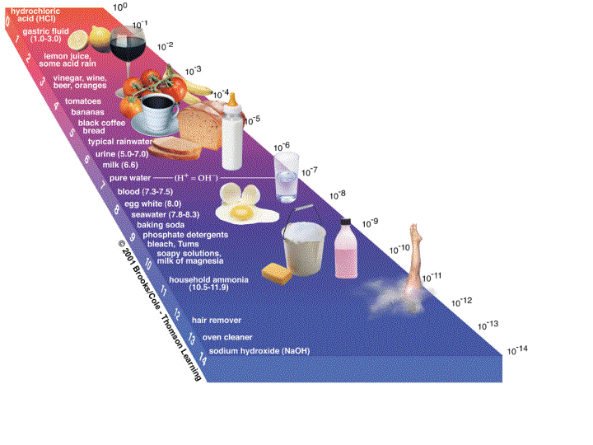
Acid and Base Scale
Acids pH from 0 to 7
Neutral pH is 7
Base pH from 7 to 14
pH is a measure of H⁺
pH = -log[H⁺]

Slide 14
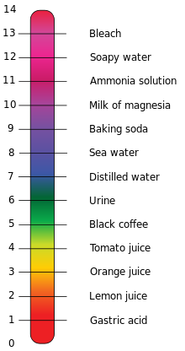
Liquid A has a pH of 10,
Liquid B has a pH of 3
Liquid C has a pH of 7
Do you get it?
1. Which liquid could be pure water?
2. Rank the liquids in order from most acidic to least acidic.
3. Which liquid might be a solution of sodium hydroxide?
4. Which liquid has the fewest hydroxide ions dissolved in water?
5. Which liquid might be hydrochloric acid?

Slide 15
Checking In!
Answers:
C
B>C>A
A
B
B
pH Base:
7-14
pH Neutral:
7
pH Acid:
0-7

Slide 16
Liquid A has a pH of 10,
Liquid B has a pH of 3
Liquid C has a pH of 7
6. Which liquid has the fewest hydrogen ions dissolved in water?
7. Which liquid has the most hydroxide ions dissolved in water?
8. Rank the liquids in order from most basic to least basic.
9. Which liquid has the most hydrogen ions dissolved in water?
10. In which liquid does the number of hydrogen ions equal the number of hydroxide ions?

Slide 17
Checking In!
Answers:
A
A
A>C>B
B
C
pH Base:
7-14
pH Neutral:
7
pH Acid:
0-7

Slide 18
pH means what?
A measure of concentration of H⁺ ions
pH = -log[H⁺] need to go backwards? [H⁺] = 10^{-pH}
Therefore, the more H⁺ the lower the pH
H
H
H⁺
H⁺
H⁺
H⁺
H⁺
H⁺
H⁺
H⁺
H⁺
H⁺
H⁺
H⁺
H⁺
H⁺
H⁺
H⁺
H⁺
H⁺

Slide 19
Example Calculation
Calculate the pH of hydrochloric acid with a H⁺ concentration of 5.69 x 10⁻¹
pH = -log[H⁺]
pH = -log[5.69 x 10⁻¹]
pH = 0.245

Slide 20
Practice Calculation
What is the pH of a 1.2 x 10⁻³ HBr solution?
2.9
What is the pH of a 2.34 x 10⁻⁵ HNO₃ solution?
4.63

Slide 21
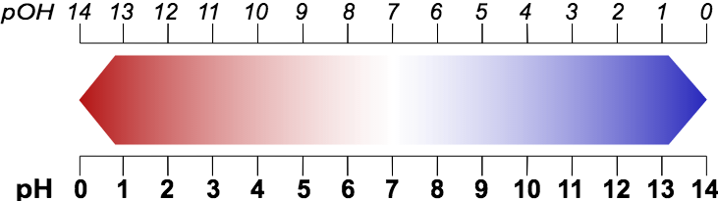
pH and pOH

Slide 22
pOH means what?
A measure of concentration of OH⁻ ions
pOH = -log[OH⁻] need to go backwards? [OH⁻] = 10^{-pOH}
Therefore, the more OH⁻ the lower the pOH
H
H
H⁺
H⁺
H⁺
H⁺
H⁺
H⁺
H⁺
H⁺
H⁺
H⁺
H⁺
H⁺
H⁺
H⁺
H⁺
H⁺
H⁺
H⁺

Slide 23
ALL THE MATH. Don’t write this. Ugh.
pH + pOH = 14
pH = -log [H⁺]
[H⁺] = 10^{-pH}
pOH = -log [OH⁻]
[OH⁻] = 10^{-pOH}
[H⁺] x [OH⁻] = 1x10⁻¹⁴

Slide 24
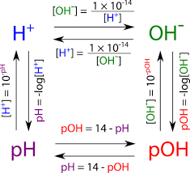
Numerical Relationships!

Slide 25
Indicators
Change colors with a change in pH

Slide 26
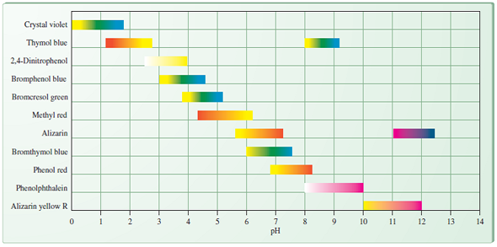
Indicators

Slide 27
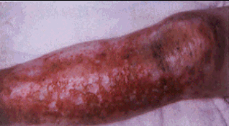
Acid or Base and Skin…
Severity will vary with concentration, but
BE SAFE, NOT SORRY!!
Rinse skin IMMEDIATELY and call for Ms. Kovach

